Slide 2
Setting the Stage: Contextual Realities for Congregations

Slide 3
For the first time in Gallup poll’s history, in 2020 church membership in the U.S. fell below 50% in America.
In 2021, Gallup cited that in eight decades of tracking American religious membership, more adults in the U.S. do not attend church than those who do.

Slide 4
More people have left the church in the last 25 years than all the new people who became Christians from the First Great Awakening, Second Great Awakening, and Billy Graham crusades combined.

Slide 5
There is a growing percentage of nones—those with no religious affiliation.
Think “converts,” but going from a religion to having none.
The single biggest fueler of the rapid growth in those claiming no religious affiliation, is nonversion. The propensity of people brought up with a religious affiliation to lose it, and having done so, to feel little need to acquire another.

Slide 6
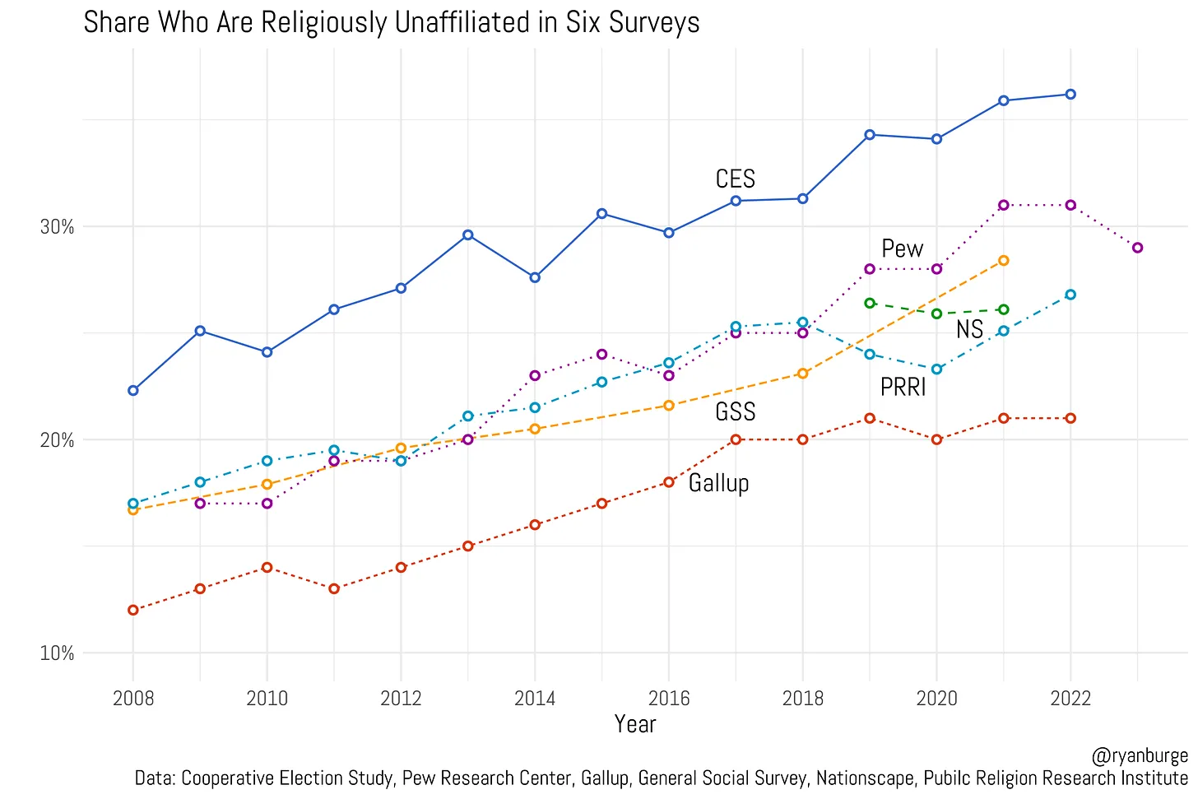

Slide 7
Churches in the U.S. are facing pressures—both external and internal.
Changing demographics
A loss of trust in institutions
A global pandemic
Increasing political polarization
Evolving social norms
Racial division
The consolidation of people into larger and larger churches
The increasing frailty of small ‘ordinary congregations’
Tension over how to deal with the issues of sexuality
Unhealthy pastoral leadership models

Slide 8
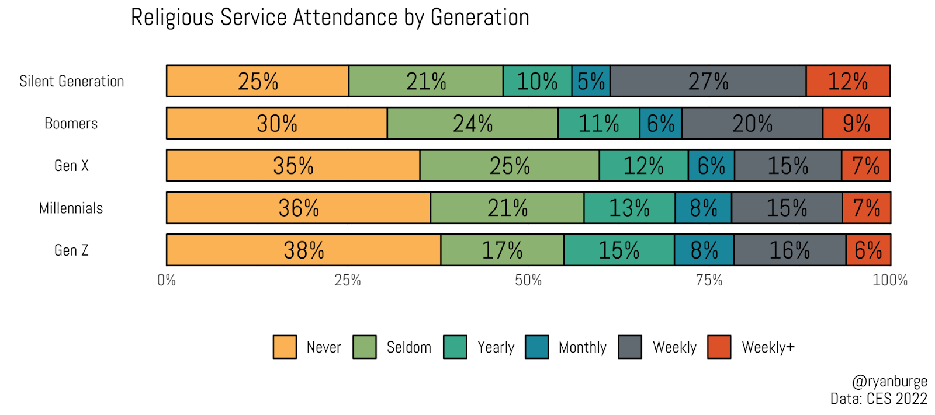

Slide 9
Reasons for Not Attending or Leaving a Church
I struggled to fit in or belong
I moved to new community
I found community elsewhere
I no longer believed what the congregation did
I have other priorities for my time and money
Attending was inconvenient
Divorce, remarriage, another family change
COVID got me out of the habit
I didn’t experience much love from the congregation

Slide 10
Passing on the faith— the key transition phases
High School
College
New Career

Slide 11
According to the 2020 U.S. Religion Census, there were 11,881 Church of Christ congregations
with 1,422,331 adherents.
https://thearda.com/us-religion/census/congregational-membership?t=4&y=2020#REPORT

Slide 12
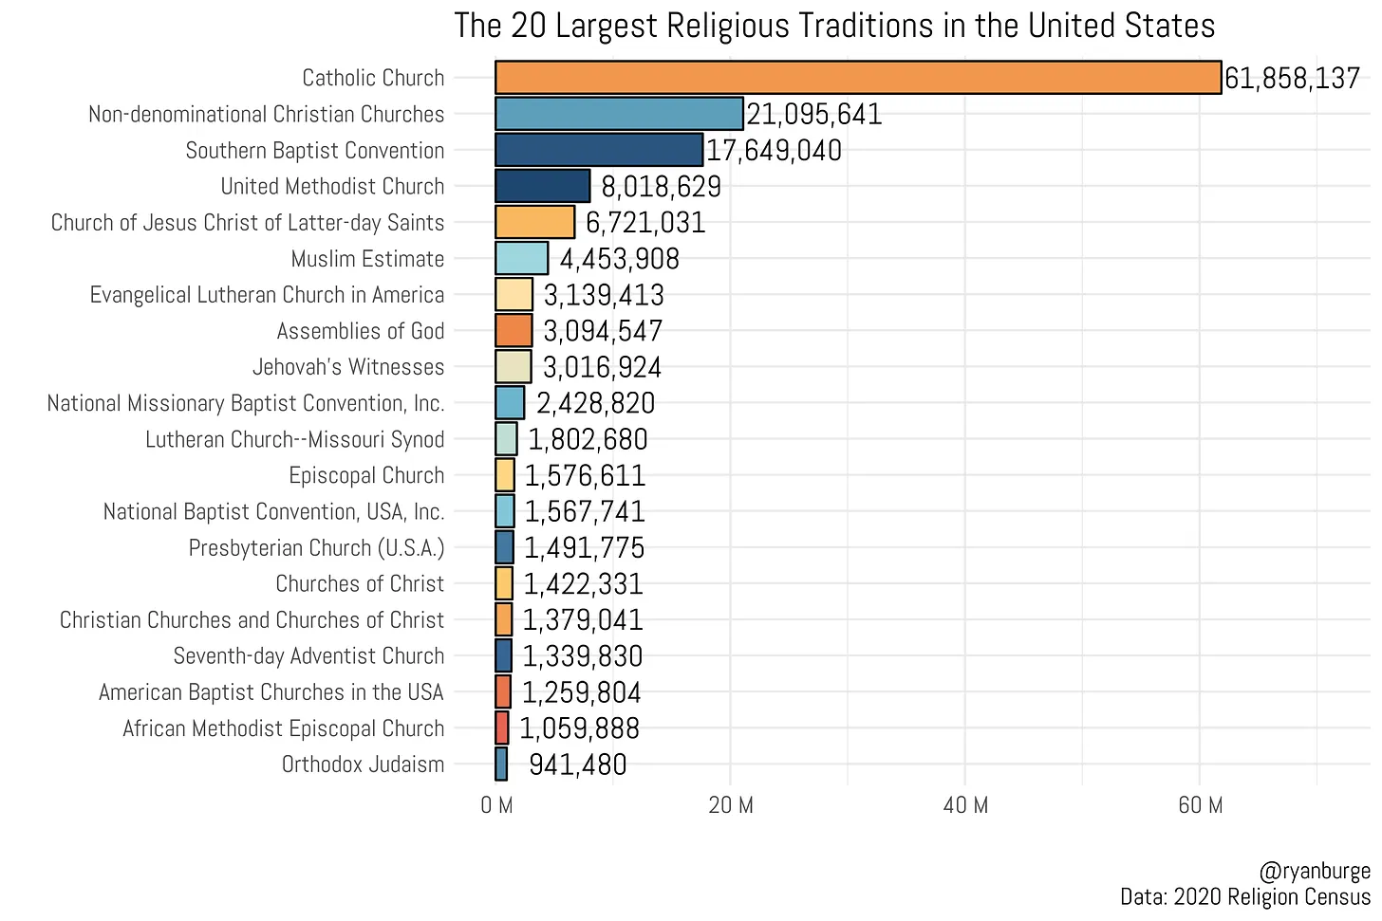

Slide 14
Life on the Vine
REFRAMING MINISTRY & LEADERSHIP IN A SEASON OF PRUNING

Slide 15
John 15:1-5
I am the true vine, and my Father is the vine-grower. He removes every branch in me that bears no fruit. Every branch that bears fruit he prunes to make it bear more fruit. You have already been cleansed by the word that I have spoken to you. Abide in me as I abide in you. Just as the branch cannot bear fruit by itself unless it abides in the vine, neither can you unless you abide in me. I am the vine, you are the branches. Those who abide in me and I in them bear much fruit, because apart from me you can do nothing.

Slide 16
Pruning the Fruitless
“HE REMOVES EVERY BRANCH IN ME THAT BEARS NO FRUIT…”

Slide 17
Pruning for Growth
EVERY BRANCH THAT BEARS FRUIT HE PRUNES TO MAKE IT BEAR MORE FRUIT…

Slide 18
Ministry in a Season of Pruning…
THOSE WHO ABIDE IN ME AND I IN THEM BEAR MUCH FRUIT, BECAUSE APART FROM ME YOU CAN DO NOTHING…

Slide 20
Practices to Help Us Pay Attention to God
David Kneip

Slide 21
Why Spiritual “Practices”?
“Spiritual disciplines”
Just “doing what I do”
Putting ourselves in the paths of God’s grace

Slide 22
Dwelling in the Word
Prayer and Bible reading
Meditative reading → transformation
Some recommendations
Sharing what happens

Slide 23
Interacting “Out in Town”
Treat them as companions
Do not think or speak evil of them
Pray for them
Encourage them to do good
Collaborate with them in ministry

Slide 24
Openness and Relinquishment
Assumptions about your prayer life
“What is your will for me today?”
Giving up my attachments
Gethsemane

Slide 26
Leading When You are Not the Leader
Equipping Leaders for Mission

Slide 27
Stop
Waiting on the Lord
Prayer
Tell Stories (Read the Bible)
Worship

Slide 28
Look
What is God doing in your congregation and community?

Slide 29
Listen
Attend, not Advocate
Discern, not Decide
Let go, not hold on

Slide 31
Leadership Frames for Churches on Mission
Equipping Leaders for Mission

Slide 32
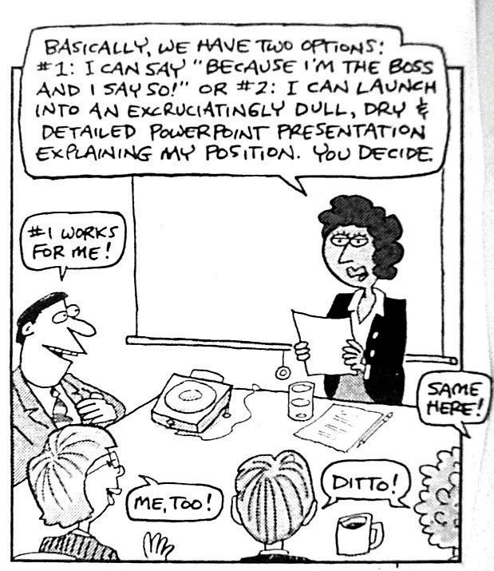
The World Has Changed: So Must Leadership
Notes:
Throughout the day we have been hearing the realities of the change in our world—diversity, pluralism, tribalism. It is changing the way we think about leadership.
We are also encountering, at greater and greater rates, what the US Military calls VUCA situations (Volatility, Uncertainty, Complexity, and Ambiguity).
**Stanley McChrystal—the lone heroic leader.
**Kellerman

Slide 33
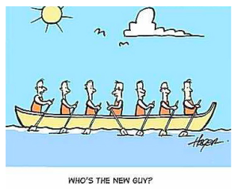
The Dilemma
Elders’ meetings can be endless
Ministers and elders often disconnect
Ministry Leaders unclear
Churches languish

Slide 34
Common Dynamics for Leadership Teams
Guardians at the gate
Keepers of the Peace
Representative Dynamics
Micromanagers
Rubber Stamp

Slide 35
Common Blunders
We have technology (or data), so we can fix it. (False assumption that discipleship and mission are technical—not adaptive—challenges.)
Leaders need to assert greater control toward preferred outcomes. (False assumption that generally leads to micro-management and lack of volunteerism.)
Fix the church and we will fix the world. (False assumption that contributes being “church-centric” rather than “kingdom-centric.”)
Fire or fix the minister. (False assumption that clouds the systems-reality of congregations.)
Notes:
Remember theological realitites—namely God as an active agent in the world is missing in these assumptions.

Slide 36
Five Dysfunctions of a Team, Lencioni

Slide 37
Effective Teams have Positive Features:
They trust one another.
They engage in unfiltered conflict around ideas.
They commit to decisions and plans of actions.
They hold one another accountable for delivering against those plans.
They focus on the achievement of collective results.

Slide 38
Church Models
Old Model
Church is a place
where certain things
happen to provide
care and comfort
for Christian people.
Contemporary
Church is a vendor
of religious goods
and services designed
to make people
Christian
Mission
Church is a body
of people sent
on God’s mission to
restore humankind.

Slide 39
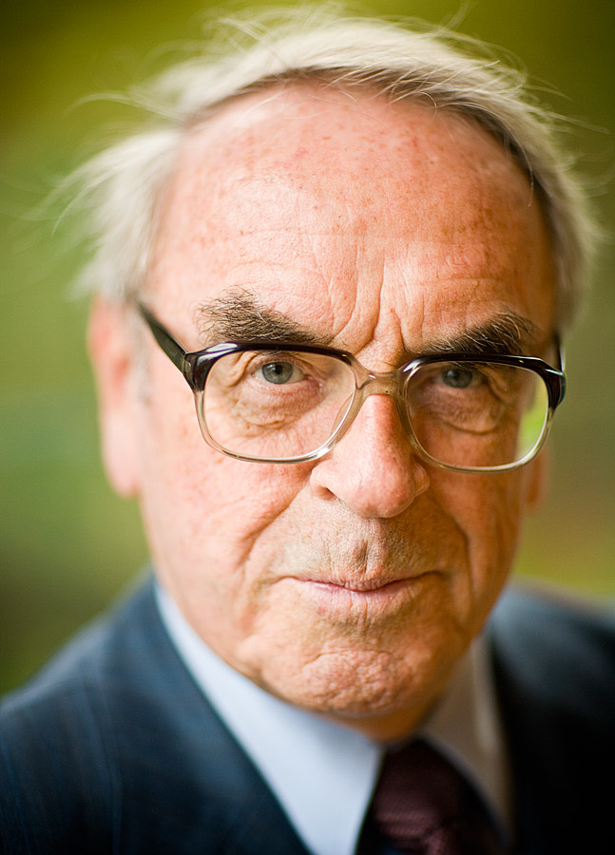
“What we have to learn . . . is not that the church ‘has’ a mission, but the very reverse: the mission of Christ creates its own church. Mission does not come from the church; it is from mission and in the light of mission that the church has to be understood.” --Jürgen Moltmann, The Church in the Power of the Spirit

Slide 40
God’s Ministry
Consummation
What?
Action?
X
Why?
Church
God’s Transforming Work
What ought?
Jesus
Call of Israel
Call of Abraham
Creation

Slide 41
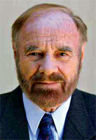
“All ministry is God’s ministry. . . . To say that all ministry is God’s ministry is to suggest that ministry precedes and determines the Church. The on-going ministry of Jesus Christ gives both content and direction to the Church in its ministry. Jesus is the minister par excellence. He ministers to the Father for the sake of the world.” --Ray Anderson

Slide 42
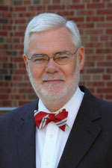
“As the risen and ascended Lord, Jesus does not now sit in heaven with his arms folded waiting for us to do something religious that he can affirm (an image from Karl Barth). Jesus is not our cheerleader from the heavens hoping we will get faith and ministry right. Neither does Jesus want to get more involved in our ministries. Why would he? Our ministries are not redemptive. We don’t raise the dead, forgive the sinful, heal the sick or bring in the reign of God. Rather, Jesus has his own resurrected ministry to do— raising the dead, forgiving the sinful, healing the sick, bringing in God’s reign (note the present tense!)—and he wants us in on it.” --Andrew Purves

Slide 43
God’s Ministry
Consummation
Church
X
God’s Transforming Work
Jesus
Call of Israel
Call of Abraham
Creation

Slide 44
Partnering with God’s Ministry
Interpretive
Leadership
X
Administrative
Leadership
Relational Leadership
Notes:
Interpretive leadership—shaping community life and practice through assisting the community in the work of reading texts, experiences, and events.
The church constantly resides at biblical, historical, contextual, and “Holy Spirit” realities. How does the congregation navigate this?
Heifetz and Linsky argue that leaders must “get to the balcony.” Leaders need to gain “both a clearer view of reality and some perspective on the bigger picture by distancing yourself from the fray.
Considered narratively, leadership tends to the work of living out the Christian story in contemporary contexts.
Otherwise, you are likely to misperceive the situation and make the wrong diagnosis,” leading to poor judgment on how to move forward.
This requires both engagement with the congregation and disengagement for reflection, prayer, and discernment.
It requires identifying whether dilemmas are “technical” problems or “adaptive” challenges. Following Craig Van Gelder, Essence of the Church (Grand Rapids: Baker, 2000), 39f.
James Thompson, The Church According to Paul: Rediscovering the Community Conformed to Christ (Grand Rapids: Baker, 2014), 241-42.
Ronald Heifetz and Marty Linsky, Leadership on the Line: Staying Alive through the Dangers of Leading (Boston: Harvard Business School Press, 2000), 53.
Relational Leadership—Healing, Sustaining, Guiding, Forming, and Reconciling.
Implemental Leadership—Fostering structures, activities, and resources in order to give relationships, ministry, and mission the necessary framework for embodiment and organization.
Structures are inherited and constantly need to be revised and reordered—to properly support present day needs.
Structures support work; they are NOT the work.
Acquiring sources, implementing vision, adjudicating conflict, fostering increased participation in meaningfully ministry, monitoring and assessing.

Slide 45
A Deeper Look
Interpretive leadership—shaping community life and practice through assisting the community in the work of reading texts, experiences, and events.
Relational Leadership—invests the relational well-being of the community, seeking wholeness and spiritual maturity in the body.
Administrative Leadership—Fostering structures, activities, and resources in order to give relationships, ministry, and mission the necessary framework for embodiment and organization.

Slide 46
NT Terms and Leadership
Elder
Interpretive
Leadership
Overseer
X
Administrative
Leadership
Relational Leadership
Shepherd

Slide 47
Biblical Leadership
Acknowledges that God seeks transformation, Jesus leads the church, and the Spirit is always present among us.
Is a God-called work to partner with God in God’s agenda.
It is practiced through three dimensions—interpreting texts and contexts through prayer and discernment, relationally attending to transformation, and implementing structures and processes to sustain healthy life and mission.
This work requires a broad community of leaders within congregations—elders, ministers, deacons, shepherds, teachers, ministry leaders, etc.
Notes:
This is NOT about having a properly “structured” governance; it is about partnering with God by attending to three practices of leadership—interpretive, relational, and implemental—work. And it will take a lot of people doing different things for that to happen in most churches.

Slide 48
Usually these tasks require not only local congregational leaders but also chosen external leaders who possess particular: a) gifts, b) training, c) dispositions
The roles are mutually held—so work on: a) who takes the lead on what; b) who decides who decides; c) how will we be accountable to each other?
Elder boards (governing boards) should hold on to only those things that are uniquely theirs to hold—and release leadership to others.
Leadership is fundamentally a response to God’s call for the sake of His mission in the world; it is not a matter of being nice or pleasing people.

Slide 49
Who Decides Who Decides?
Fiduciary Responsibility
Risk
Consistency
Symbolism
Competence

Slide 50
Recapping
Mission: The telos or ends.
Structure:
Elders’ work
Ministers’ work
Ministry Leaders/Deacons’ work
Relationship between elders and minister/ministry staff and other volunteer leaders

Slide 51
Adaptive Leadership
Be where you are--Context
Pay attention to God
Learn something
Lean into the kingdom. . . . And experiment!
Structure follows ministry
Empower others
Notes:
When something new happens—we try to make sense of it. It is what one person called the “dumb, dangerous, or different” moment.
We learn
We innovate—not knowing the outcome. It is uncertain because there are an infinite number of outcomes. But that is okay because we are paying attention to God and we will learn some more!

Slide 52
Questions
What area are you most naturally drawn to? Which area might you need to invite help with?
How well does the group of leaders in your church attend to all three areas of leadership? Where are the strengths in your leadership team? Where are the growth areas?
Paying attention to the mission of God is the most important thing. What might your team do to live out all three areas of leadership more fully in light of God’s mission? How do you empower others and release them for ministry?

Slide 53
Sources:
Alan Roxburgh. Joining God, Remaking Church, Changing the World.
Andrew Root. Christopraxis: A Practical Theology of the Cross.
Courtny B. Davis Olds. “The Growing Church: A Case Study in Leadership for Change.” Journal of Religious Leadership (Fall 2017).
Mark Lau Branson and Juan F Martinez. Churches, Cultures & Leadership: A Practical Theology of Congregations and Ethnicities.
Stanley McChrystal. Team of Teams: New Rules of Engagement for a Complex World.
Carson E. Reed. “The Geometry of a Theology of Ministry.” Restoration Quarterly. (2014).

Slide 55
Life on the Vine
Theology for a Time of Pruning

Slide 56
Ephesians 1:15-23
I have heard of your faith in the Lord Jesus and your love towards all the saints, and for this reason I do not cease to give thanks for you as I remember you in my prayers. I pray that the God of our Lord Jesus Christ, the Father of glory, may give you a spirit of wisdom and revelation as you come to know him, so that, with the eyes of your heart enlightened, you may know what is the hope to which he has called you, what are the riches of his glorious inheritance among the saints, and what is the immeasurable greatness of his power for us who believe, according to the working of his great power. God put this power to work in Christ when he raised him from the dead and seated him at his right hand in the heavenly places, far above all rule and authority and power and dominion, and above every name that is named, not only in this age but also in the age to come. And he has put all things under his feet and has made him the head over all things for the church, which is his body, the fullness of him who fills all in all.

Slide 57
THEOLOGICAL CONVICTION #1
Jesus is Risen and Active

Slide 58
THEOLOGICAL CONVICTION #2
Jesus is Free to Encounter

Slide 59
THEOLOGICAL CONVICTION #3
Jesus Empowers & Gifts

