Slide 1


Slide 2
Welcome to
McKnight Crossings
We are so glad that you are here with the McKnight Crossings family. Our prayer is that you will not only be blessed by being here, but that you will also become a greater blessing to others!
Our Shepherds and Ministry Team believe that you have the greatest opportunity to grow and develop deeper relationships if you commit to several key expectations. The more we and you stay focused on these key commitments, the greater our blessing to others becomes.
If you commit to be a part of our family, we feel a responsibility to help you in your Christian walk, as we familiarize you with this church and find places for you to belong and serve. We are holding one another to member expectations explained in this orientation and summarized below.
MEMBER EXPECTATIONS
          Live Faithfully – Ephesians 4:1
          Participate Regularly – Hebrews 10:23-25
          Serve Willingly – I Peter 4:10-11
          Give Generously – II Corinthians 9:6-7
          Speak Positively – Colossians 4:5-6
          Pray Continually – I Thessalonians 5:17
May God bless your faith walk,
Ministry Staff and Shepherds
p. 1

Slide 3
WELCOME PACKET
McKnight Crossings
Welcome Packet
OUR MISSION
A church family welcoming others into a growing relationship with Christ and His community through God’s radical hospitality.
OUR VISION
Creating a contagious culture eager to tell the good things God is doing.
OUR APPROACH
Our ministry is based on faithfully practicing three areas: 1) Delighting in God; 2) Encouraging One Another; 3) Serving Eagerly.
2515 South McKnight Road
St. Louis, Missouri 63124-1431
(314) 962-7026
www.mcknightcrossings.org
p. 2

Slide 4
McKnight Crossings
Mission Statement
A church family welcoming others into a growing relationship with Christ and His community through God’s radical hospitality.
What do the key words below, from our mission statement, say about our
core values?
    family
    welcoming
    growing relationship with Christ and His community
    God’s radical hospitality
p.3

Slide 5
McKnight Crossings
Our Core Beliefs
We have a few core beliefs that are the basis of our unity, mission, and congregational life.
About The Authority We Live By
  We affirm our submission to the authority of Christ.
    We submit to the authority of God’s Word in Scripture, always pointing us to Jesus Christ – his person, work, and words.
    The authority of the Church rests in Christ as the builder, foundation, and Head of the Body.
    Matt. 28:18-20; John 5:39, 20:30-31; Col. 1:15-18; 2 Tim. 3:16-17; Heb. 1:1-4, 4:12; 1 Cor. 3:10-11; Eph. 2:19-22
p. 4

Slide 6
McKnight Crossings
Our Core Beliefs
About Our Salvation
  We affirm the need for every person to have a saving relationship with Christ.
    Because of our sin and disobedience, we are saved through Jesus Christ as the only way to the Father.
    We are made right with God through the grace given in the life, death, burial, and resurrection of Jesus.
    We come to Christ through faith, repentance, and baptism.
    We request all members to be baptized by immersion as a pledge of commitment to God, and to receive every blessing he offers his children.
    See Matt. 28:18-20; John 14:6; Acts 2:36-38, 4:12; Eph. 2:8-9; Rom. 6
p. 5

Slide 7
McKnight Crossings
Our Core Beliefs
About Our Unity
  We affirm the priority of maintaining unity in Christ.
    Our unity is based in the cross of Jesus Christ. We maintain this unity of the Spirit by affirming:
      One Body – the Church
      One Spirit – the indwelling Holy Spirit
      One Hope – eternal life with God
      One Lord – Jesus Christ, Son of God
      One Faith – the saving message
      One Baptism – faith response to Christ
      One Father God – all things, especially God’s children, are for God’s glory.
      See Matt. 16:18; 1 Cor. 1:1-31, 3:10-11, 12:12-13; Eph. 1:22-23, 2:19-22, 4:1-16; Titus 1:2, 3:7
p. 6

Slide 8
McKnight Crossings
Our Core Beliefs
About Our Worship
  We affirm the importance of growing through worshipping Christ.
    We worship God in Spirit and Truth (as temples of the Holy Spirit and with Christ Jesus as our true High Priest). We gather to share songs, communion, prayer, the Word, our gifts, and our lives. This happens as we gather together in multiple assemblies on Sunday.
    Contemporary/Traditional Worship– at 9:30 on Sunday mornings, led by both men and women, we have a relaxed worship style with both instrumental and a cappella (rich in the Church of Christ heritage) worship.
    In small groups (Connect Groups, prayer, and breakfast groups).
    In our individual lives of prayer and devotion to God.
    We worship through lives of service to God at all times and in all places.
    See John 4:21-24; Heb. 7-10; Rom. 12:1-2; Eph. 4:1; Col. 3:1-17; Matt. 5:16; Heb. 10:25
Unity Reminder
  It is important to note what is not included in our core beliefs. This does not mean that other teachings are unimportant. It simply means they are not the basis of our unity. On many topics we may hold differing views, yet maintain the unity of the Spirit.
p. 7

Slide 9
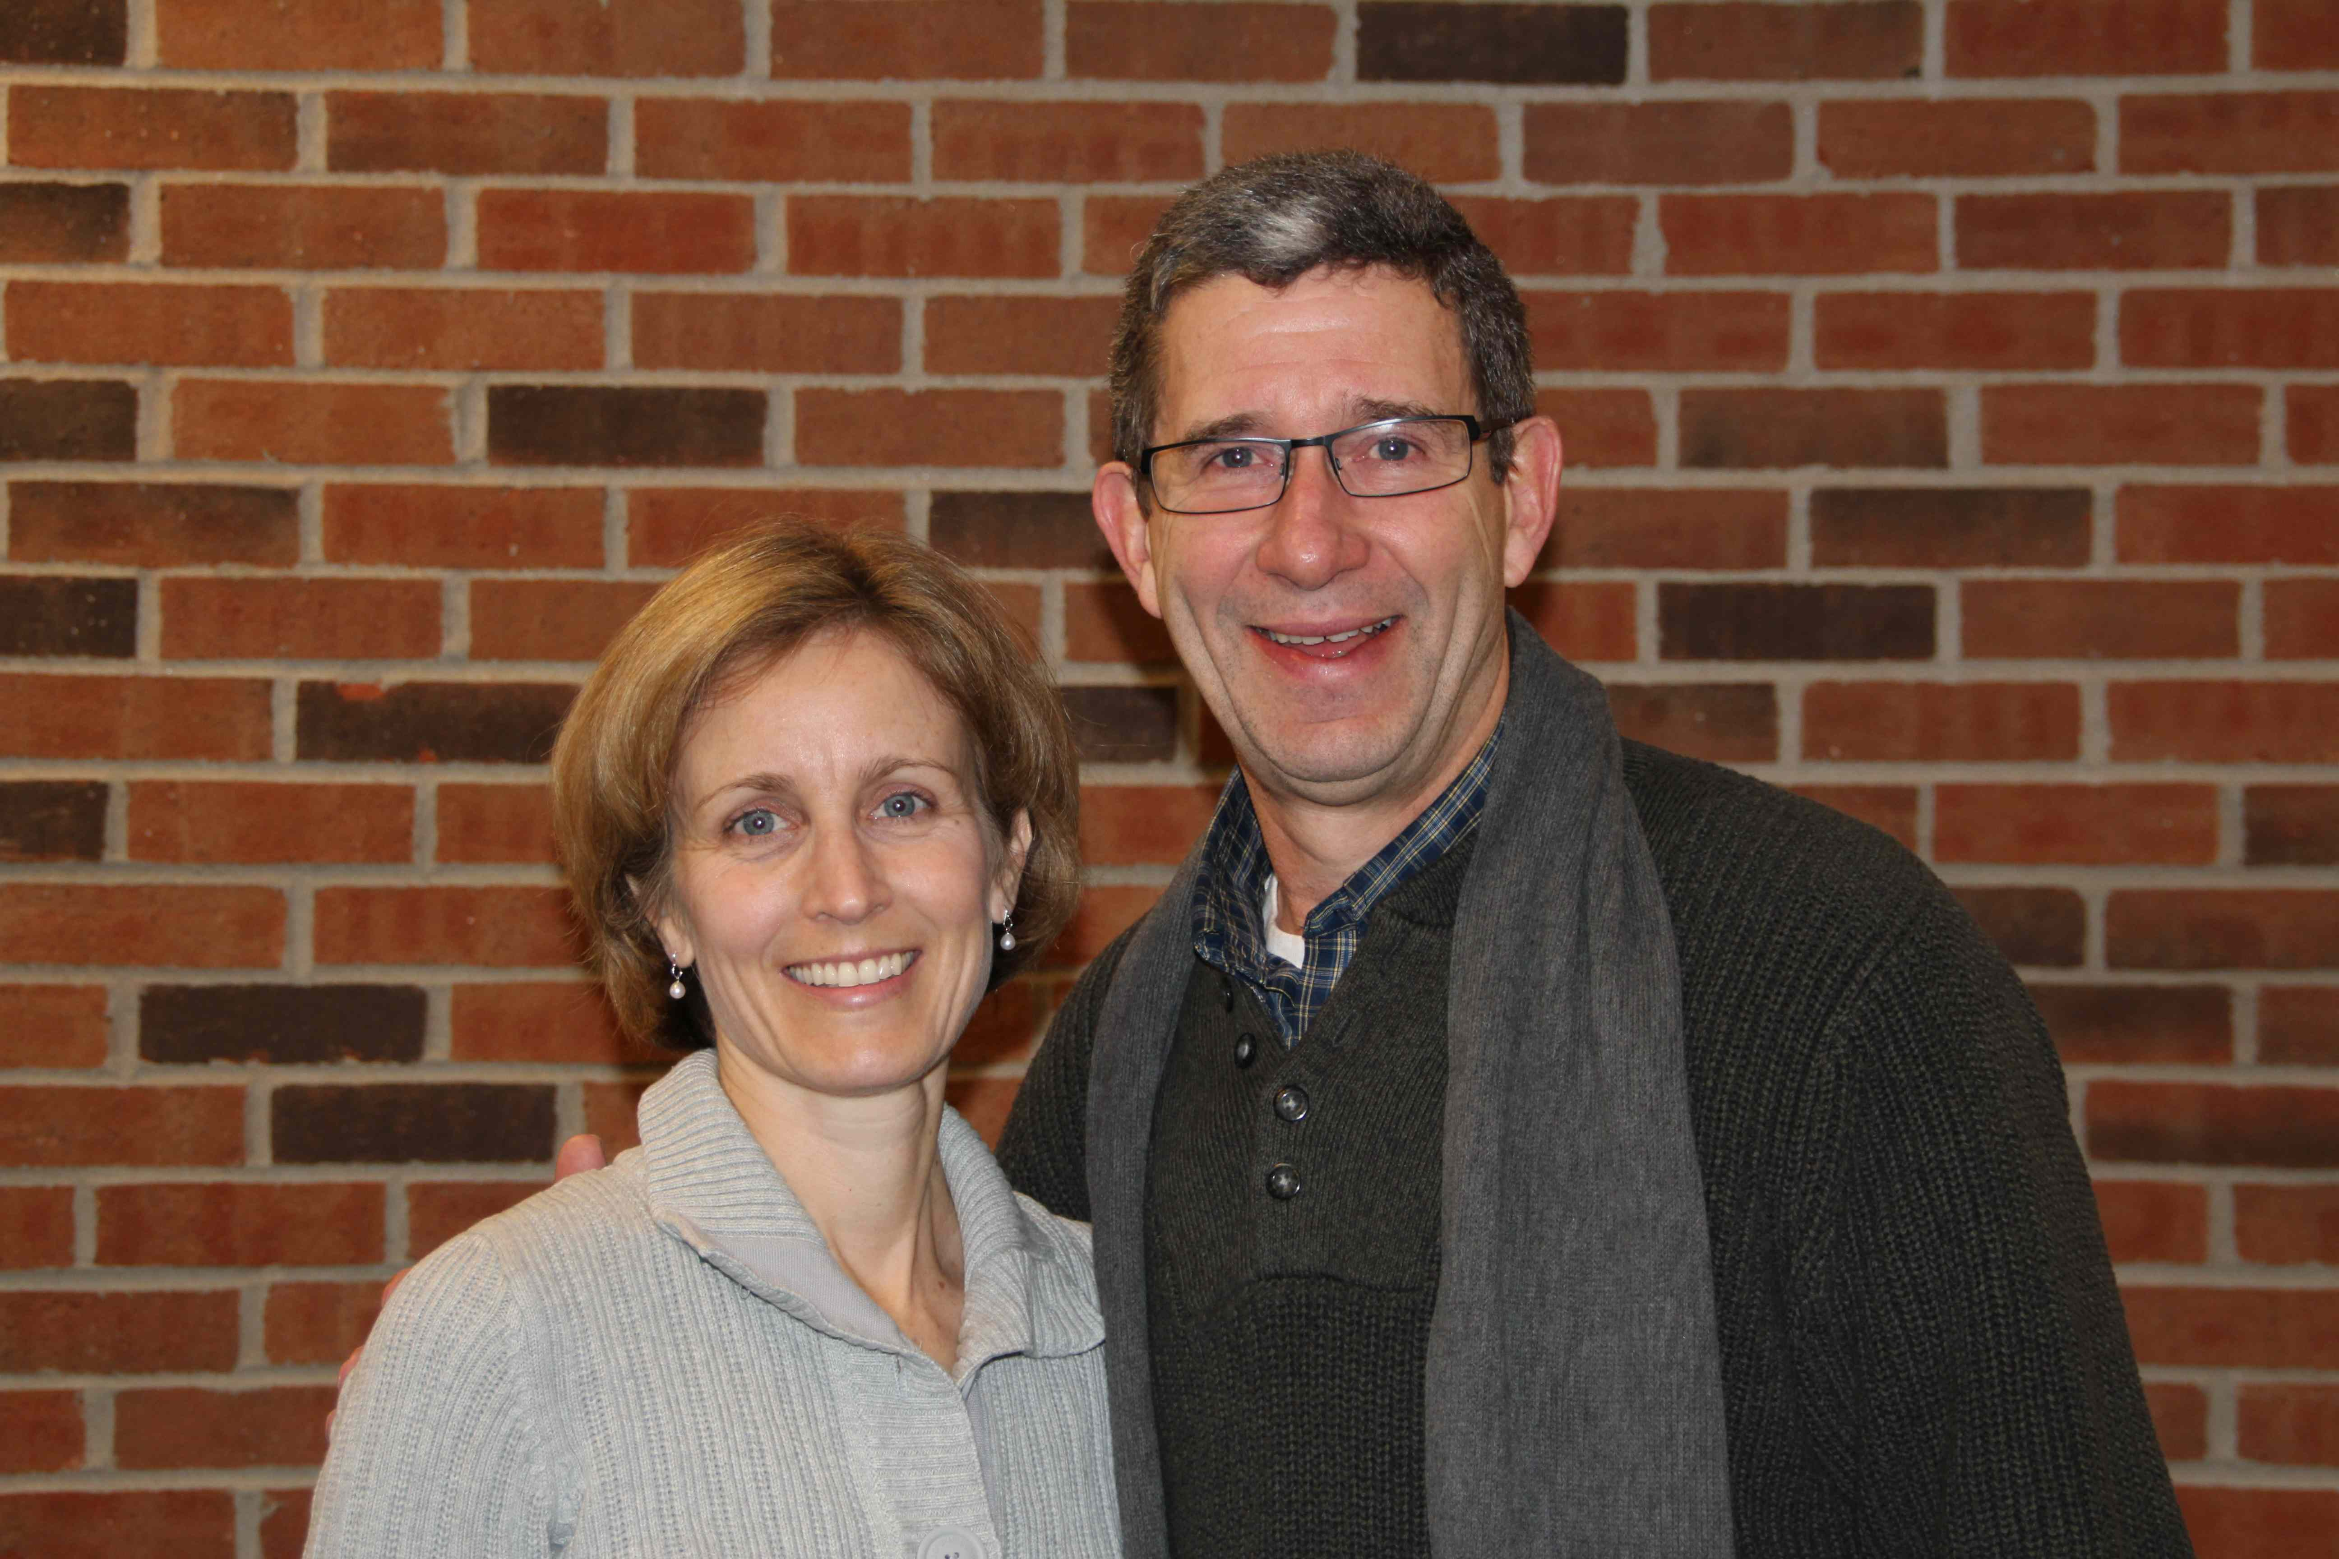
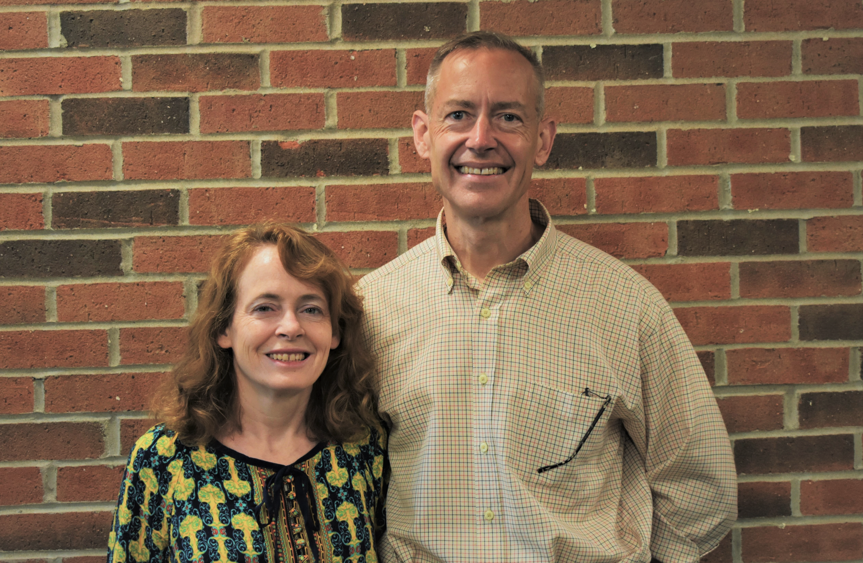
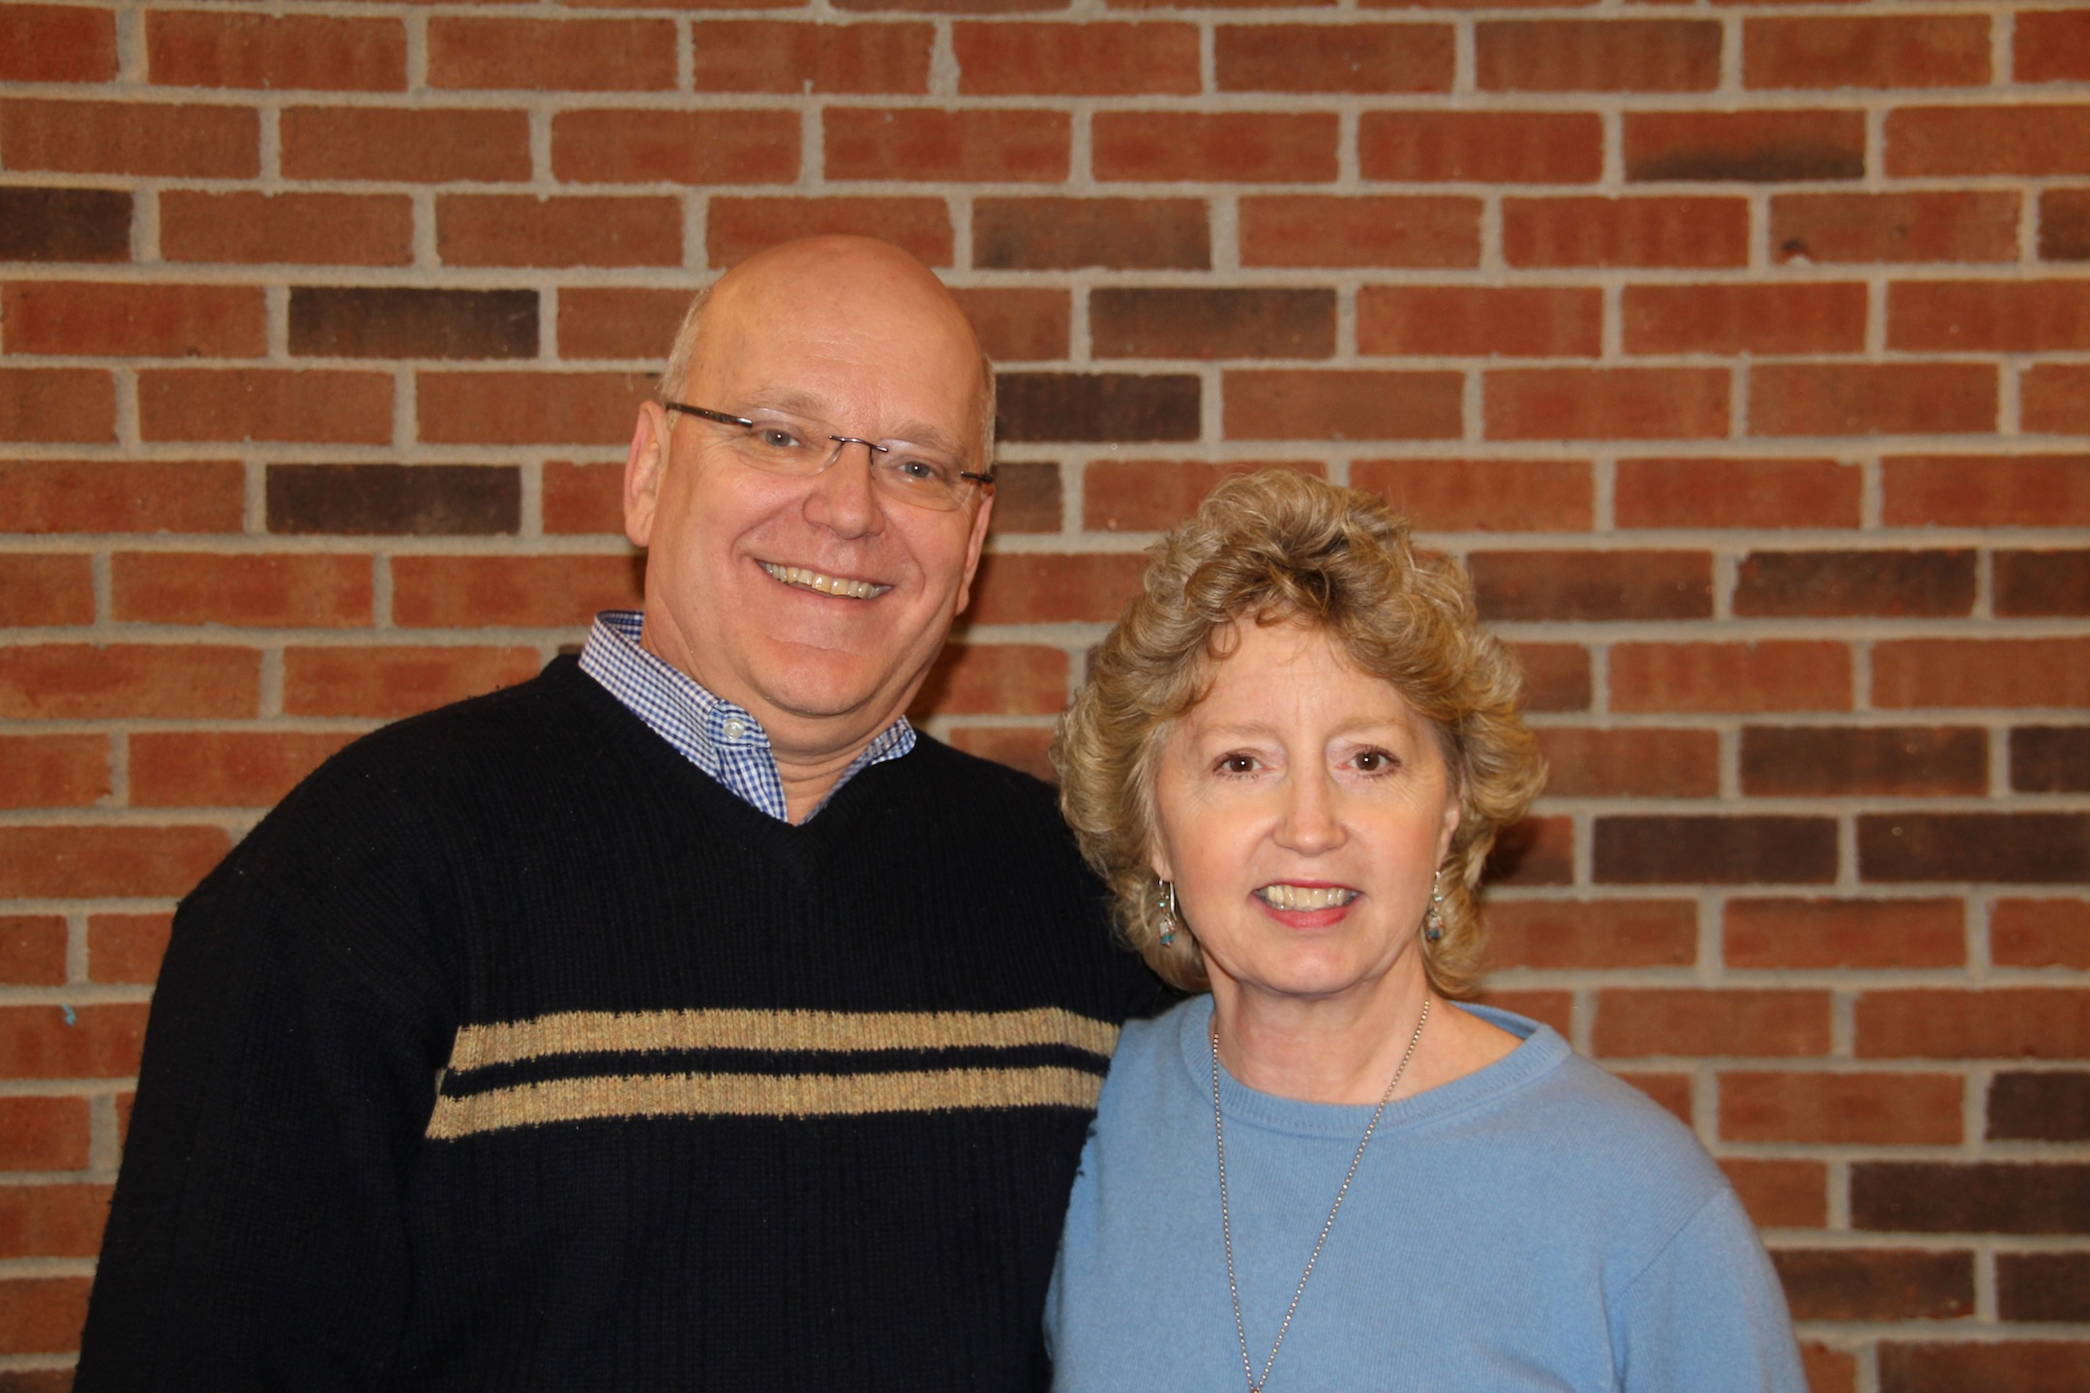
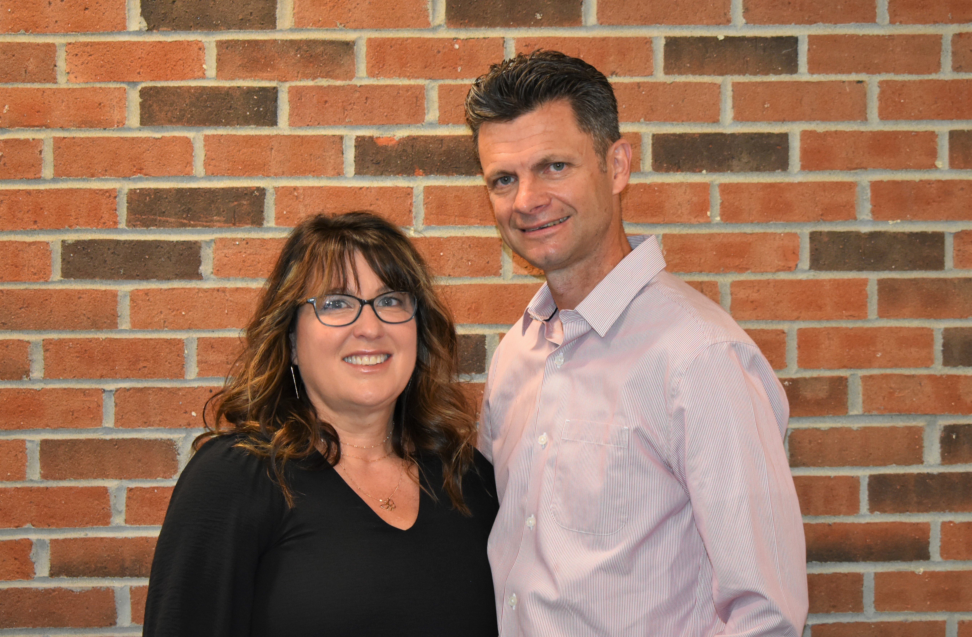
McKnight Crossings
Our Shepherds
Steve & Susan Awtrey
  Don & Debbie Fitzgerald
  Bret & Miche
  Bret & Michelle Blackford
  Lane & Kim Hamm
p. 8

Slide 10
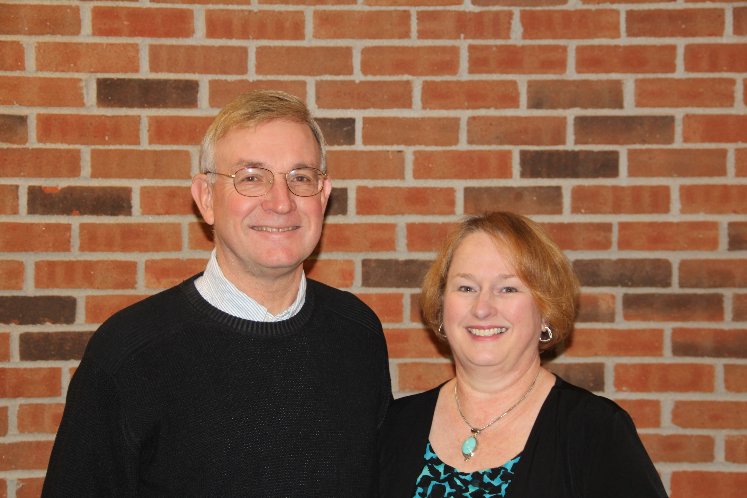
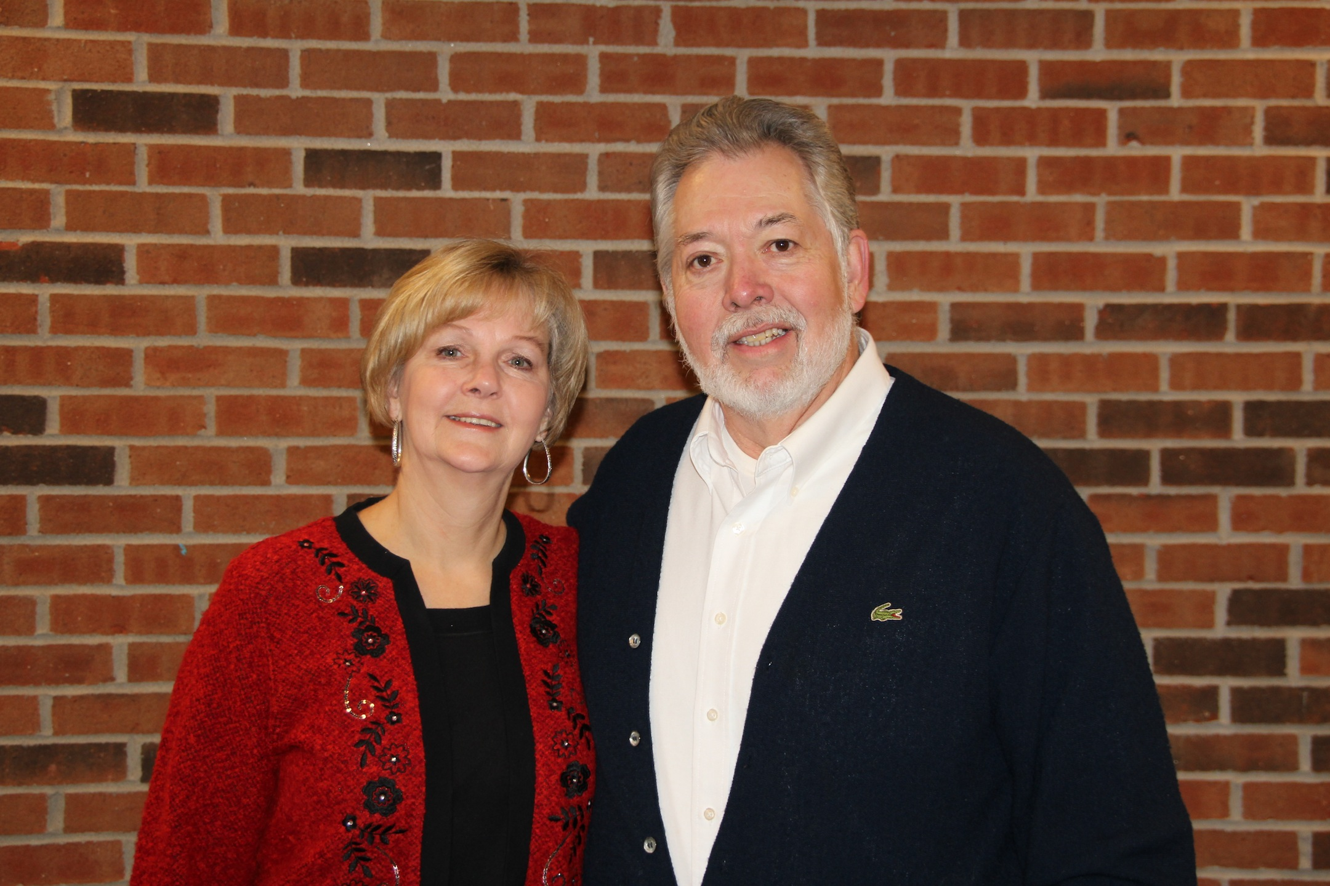
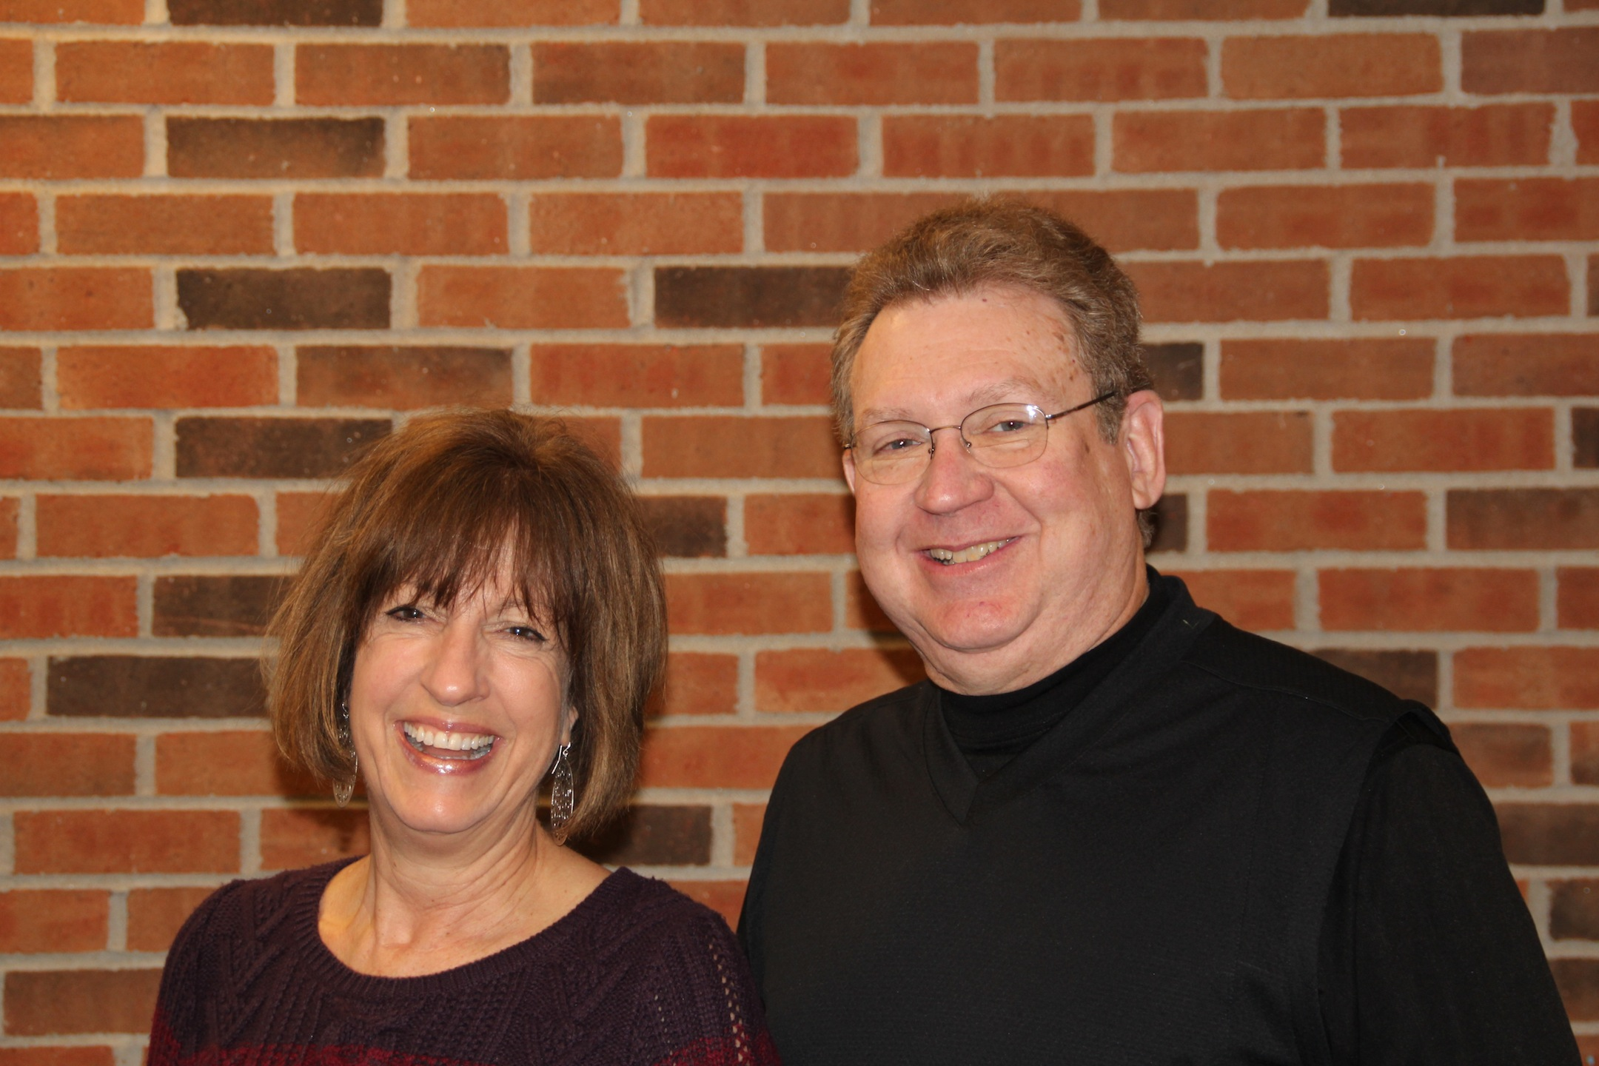
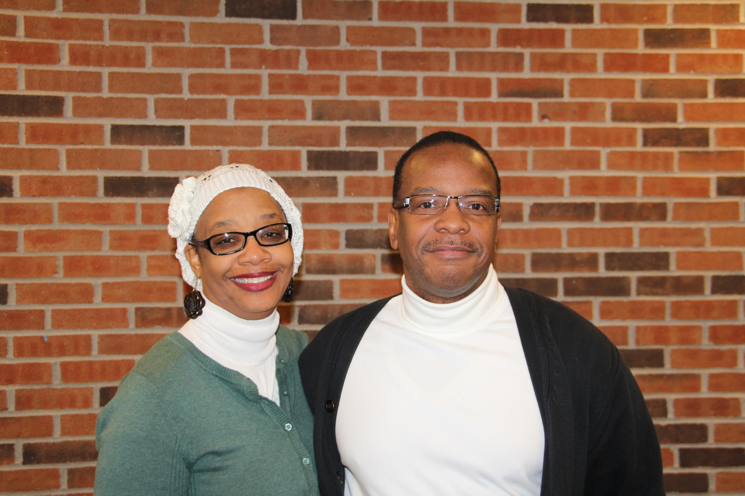
McKnight Crossings
Our Shepherds
Steve & Ann Haupt
Brad & Sue Stevens
Keaton & Kathy Jones
Steve & Gwen Walker
p. 9

Slide 11
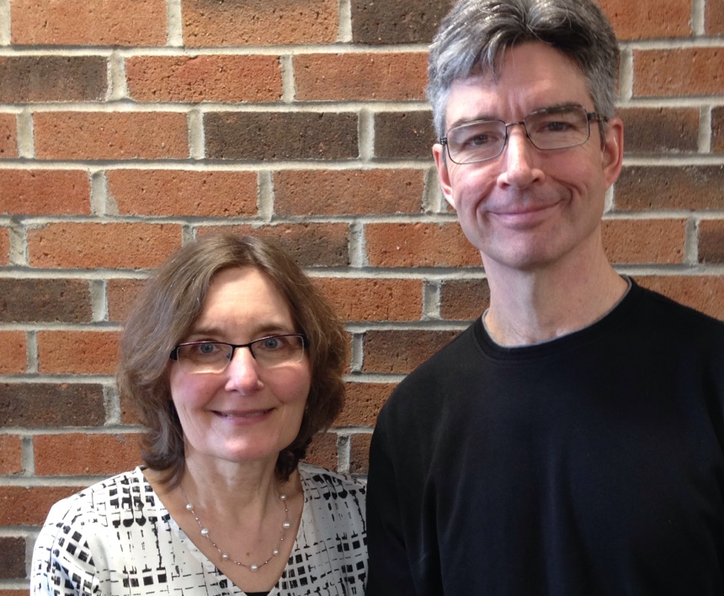
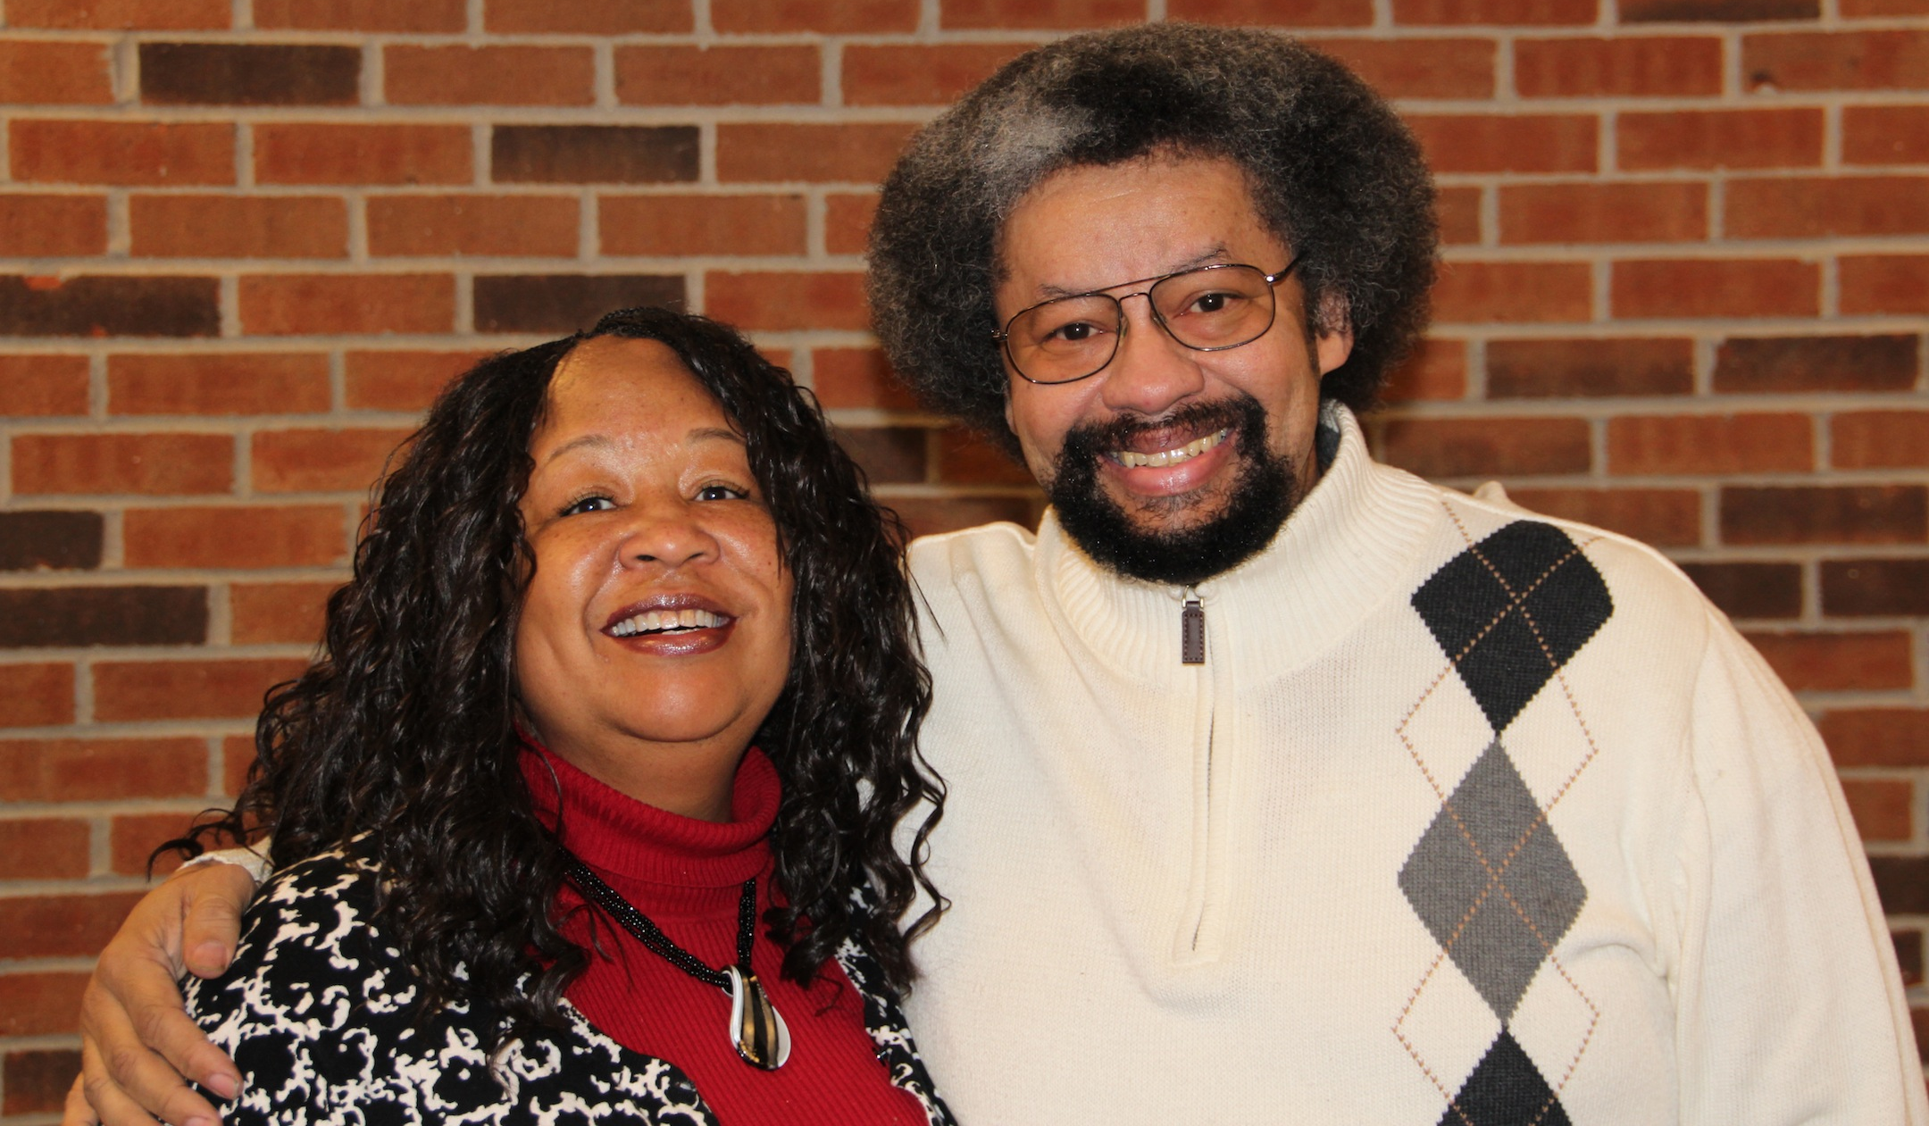
McKnight Crossings
Our Shepherds
Dave & Amy Weiler
Louis & Joyce West
p. 10

Slide 12
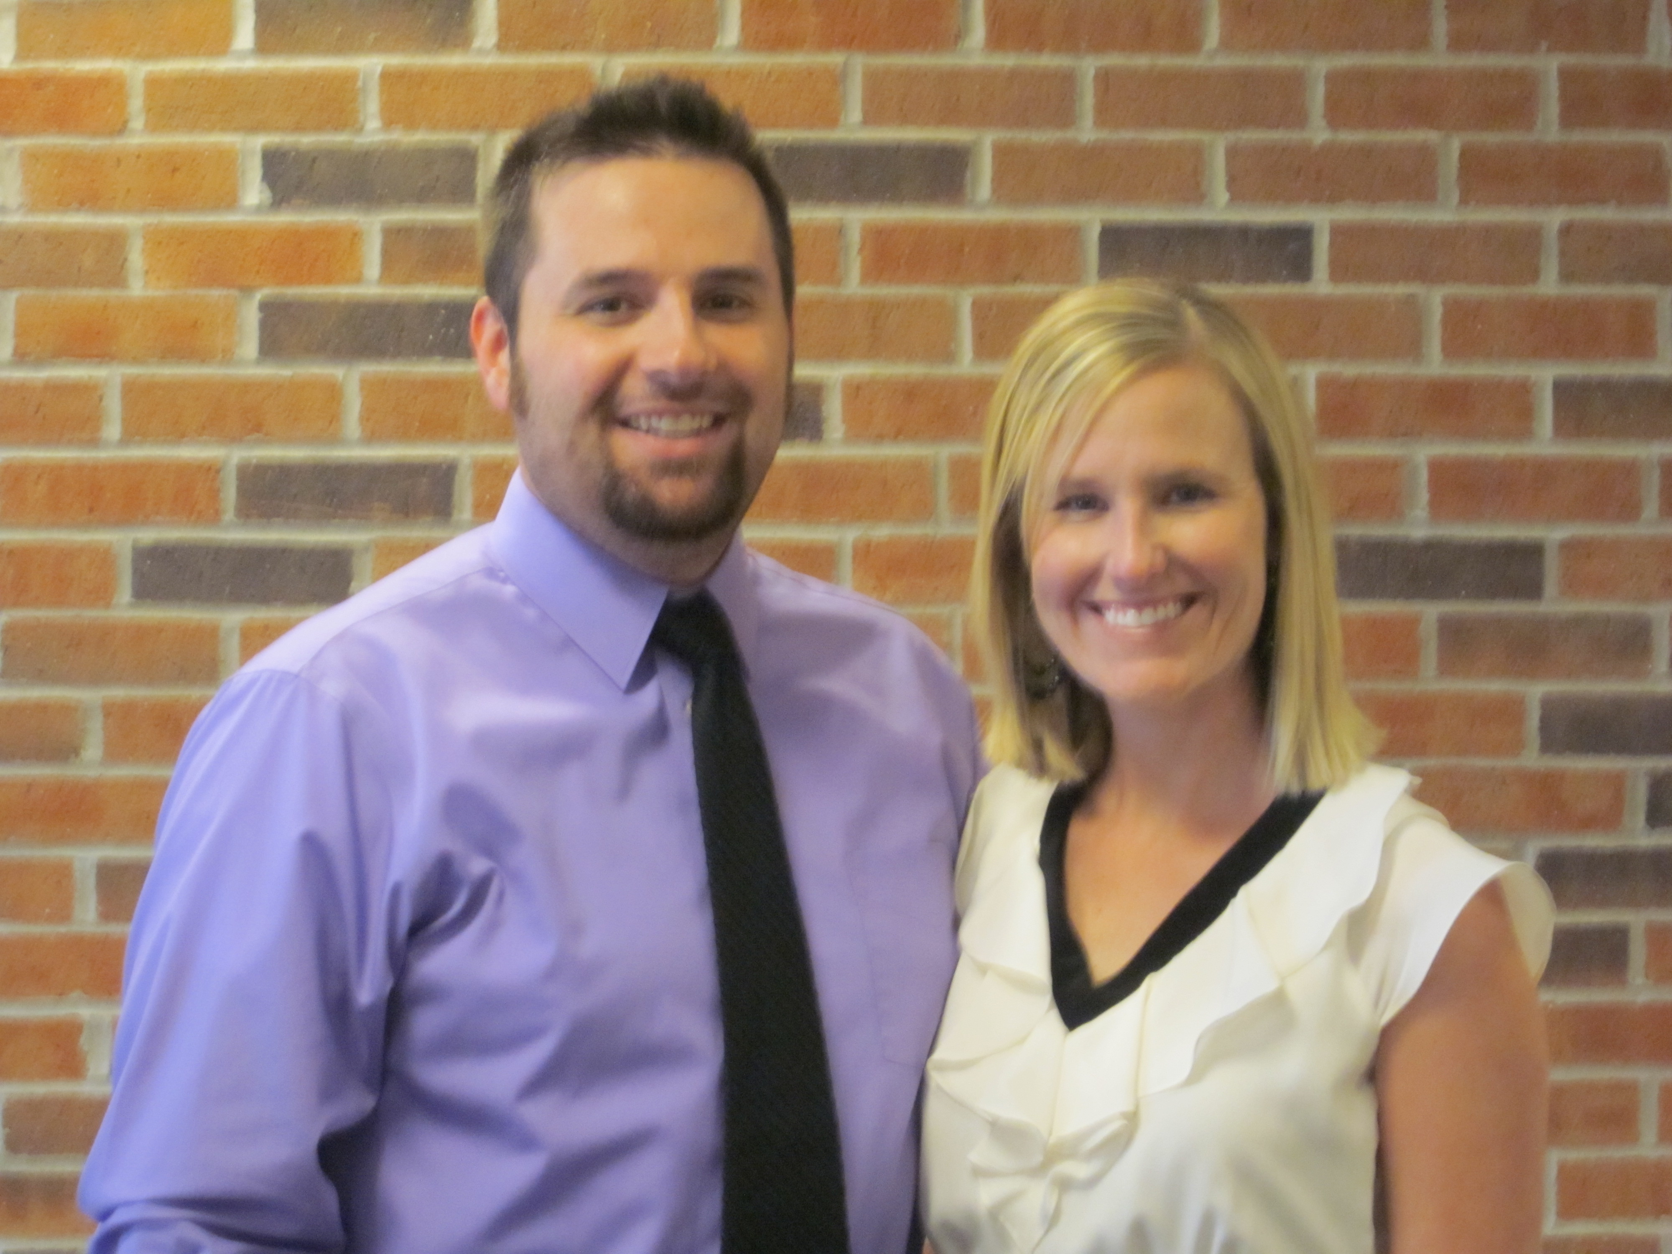
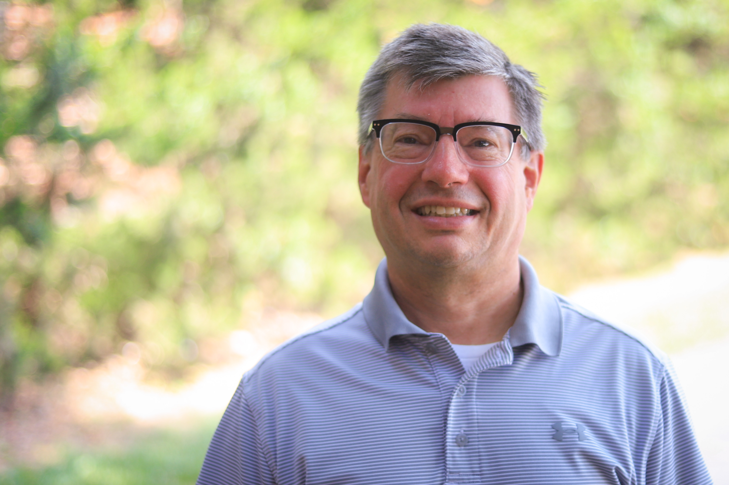
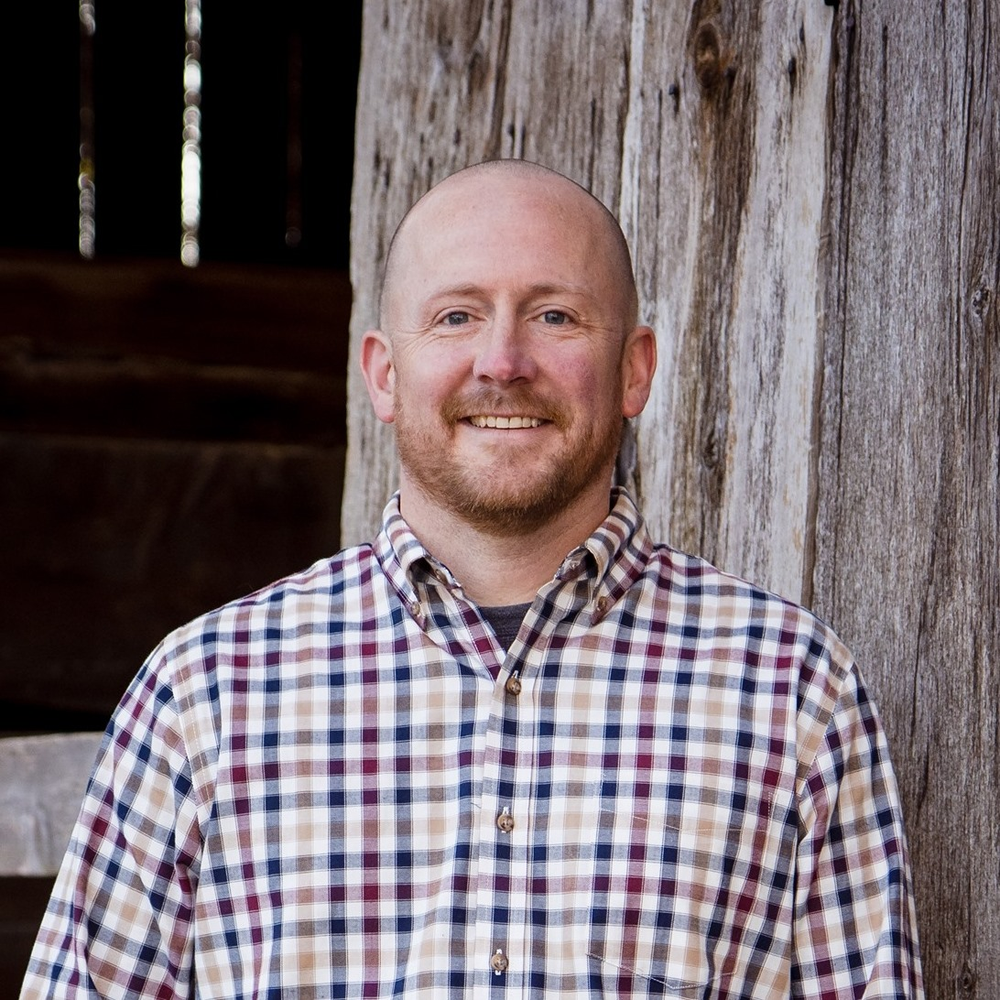
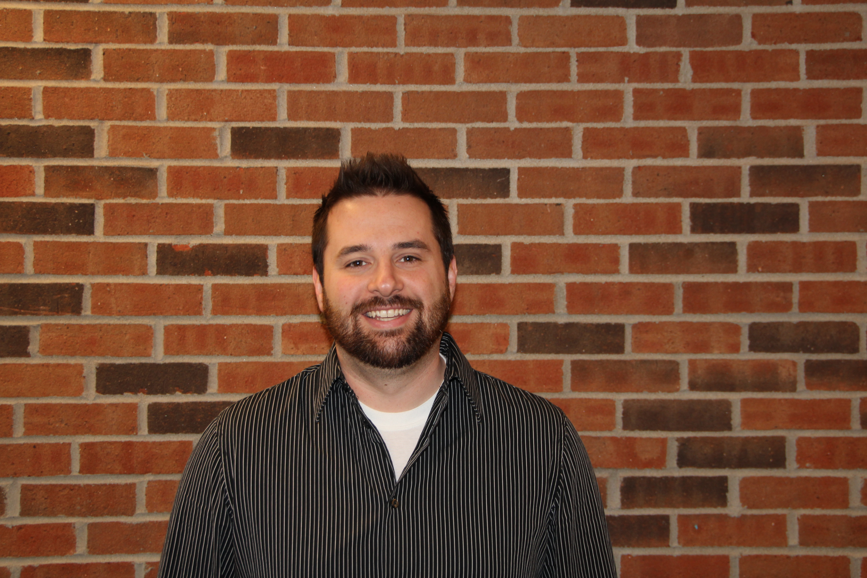
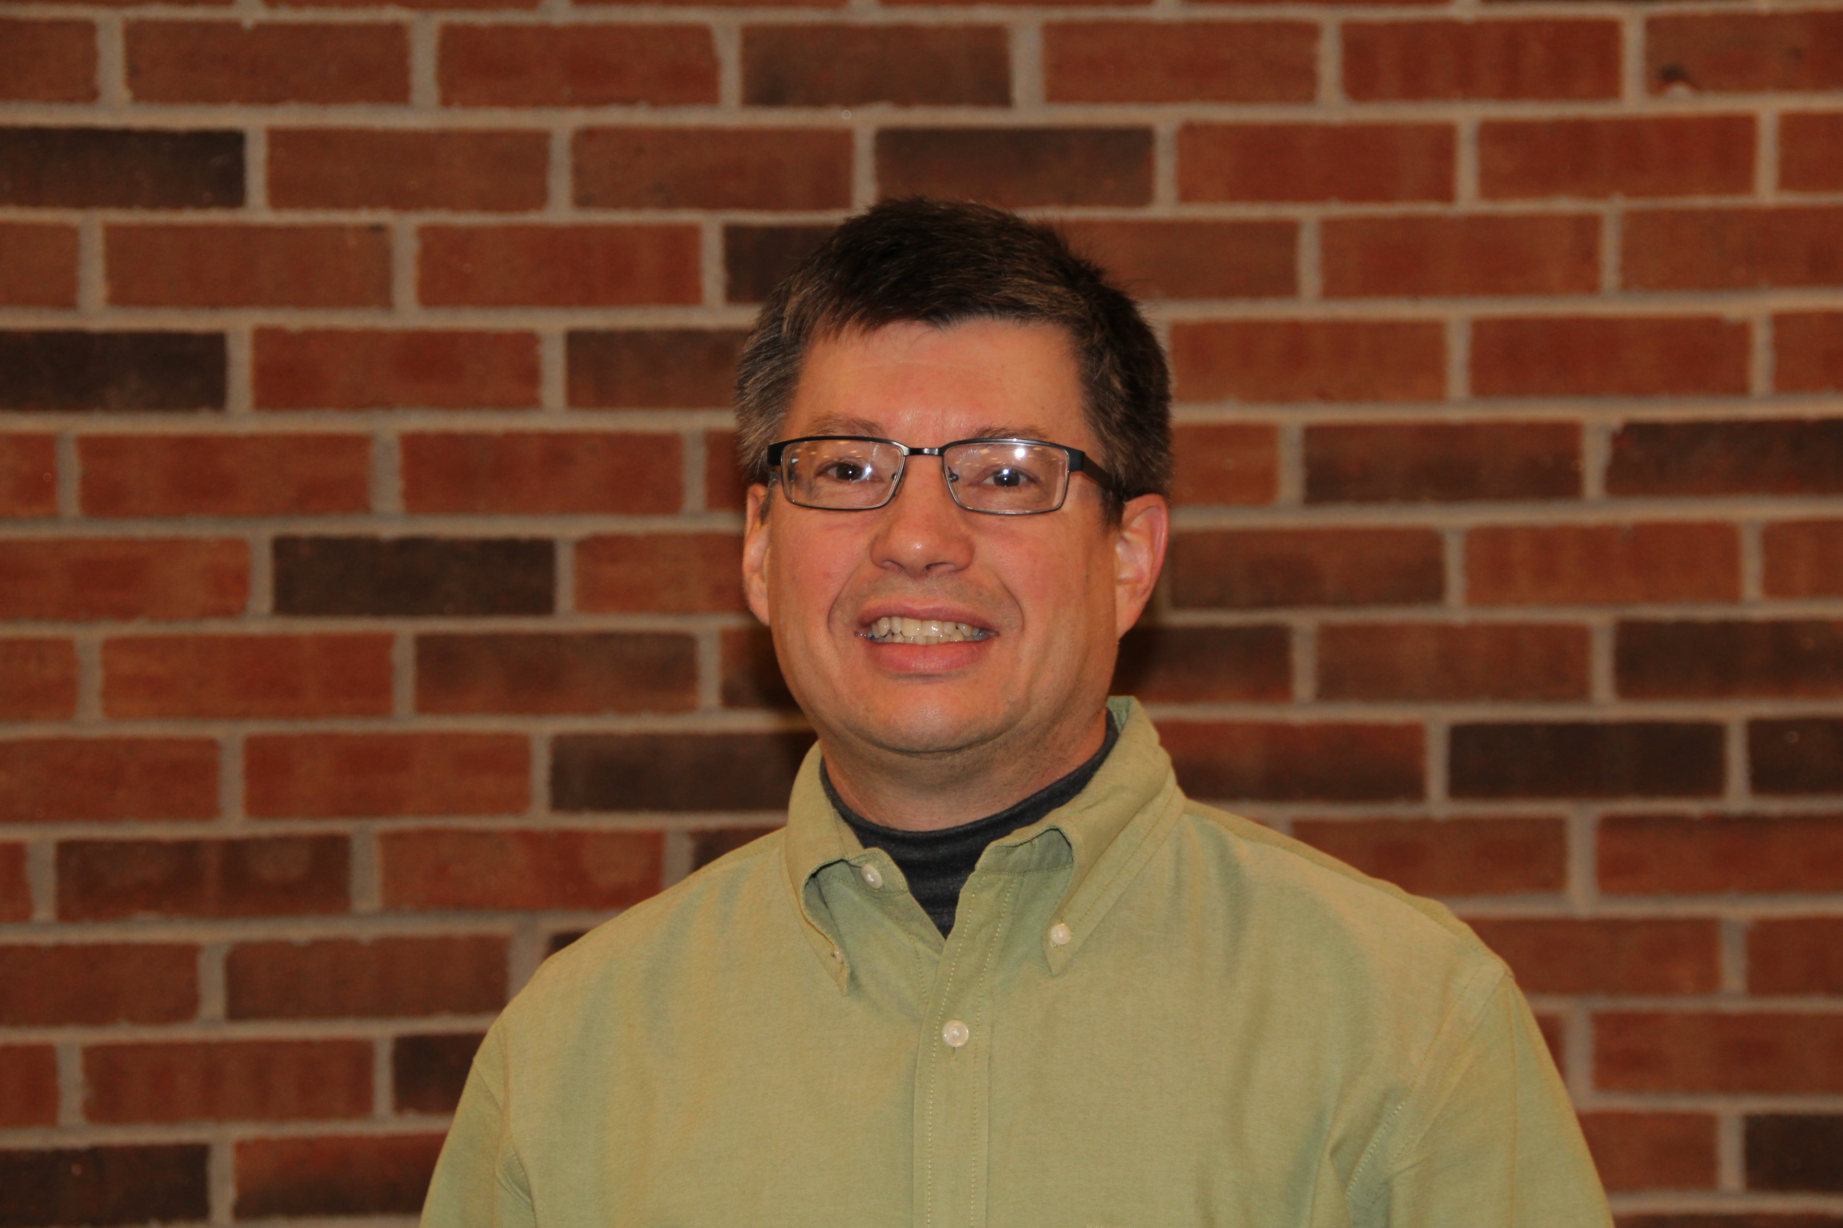
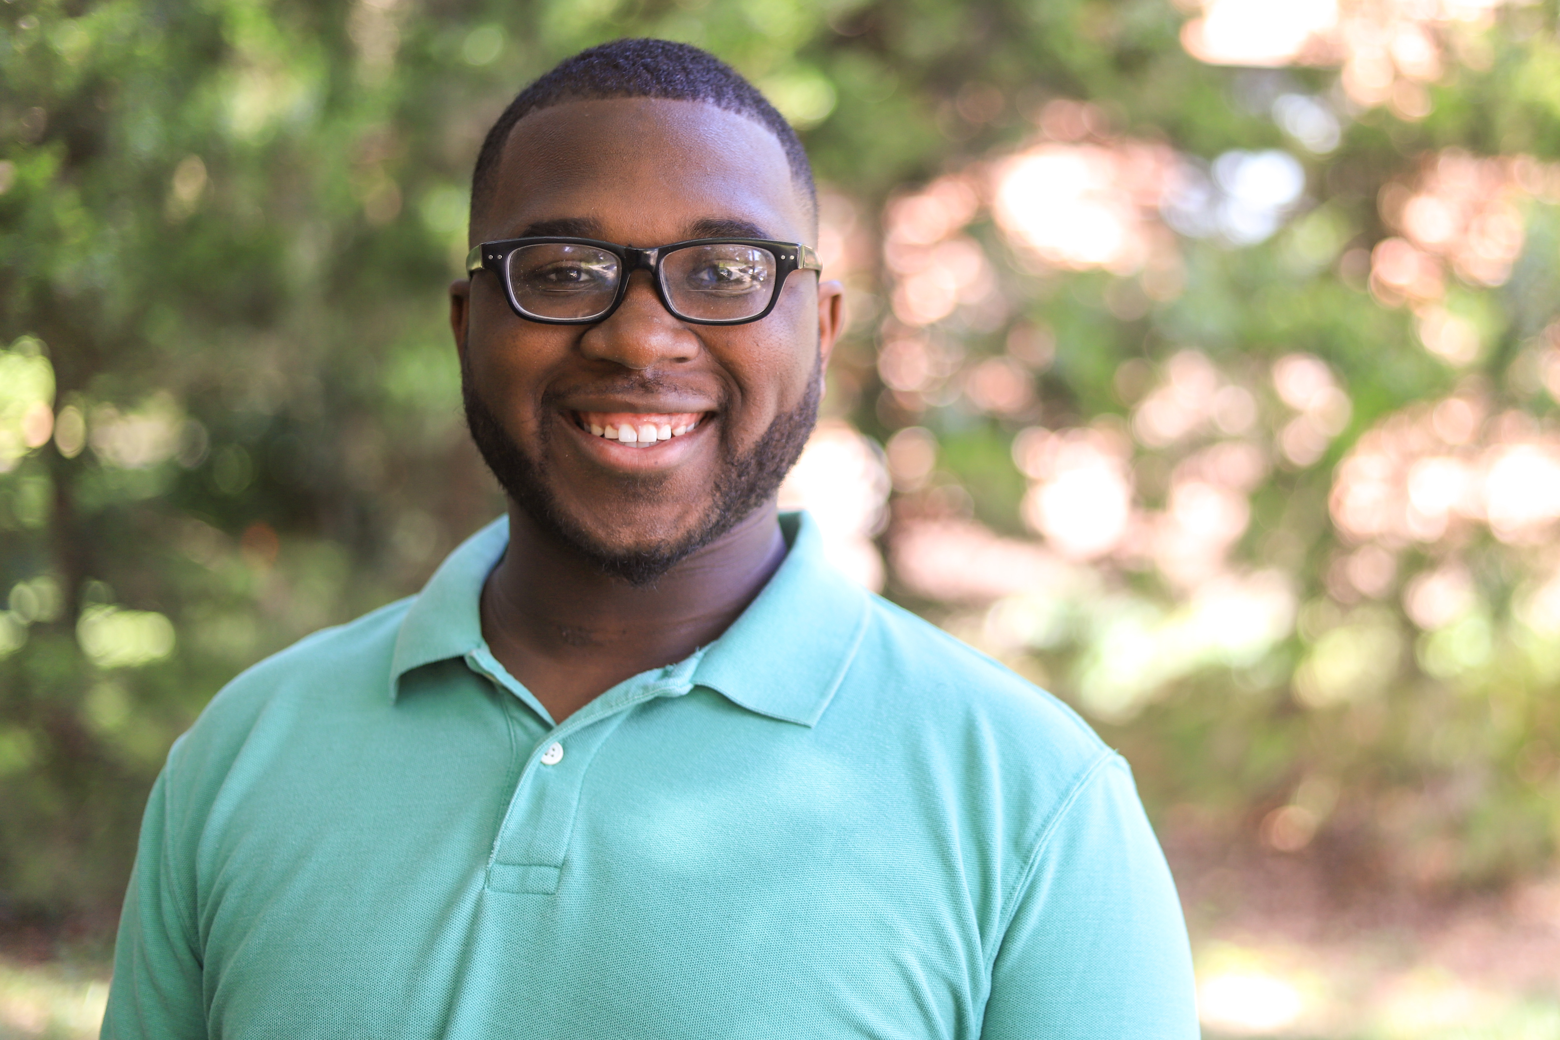
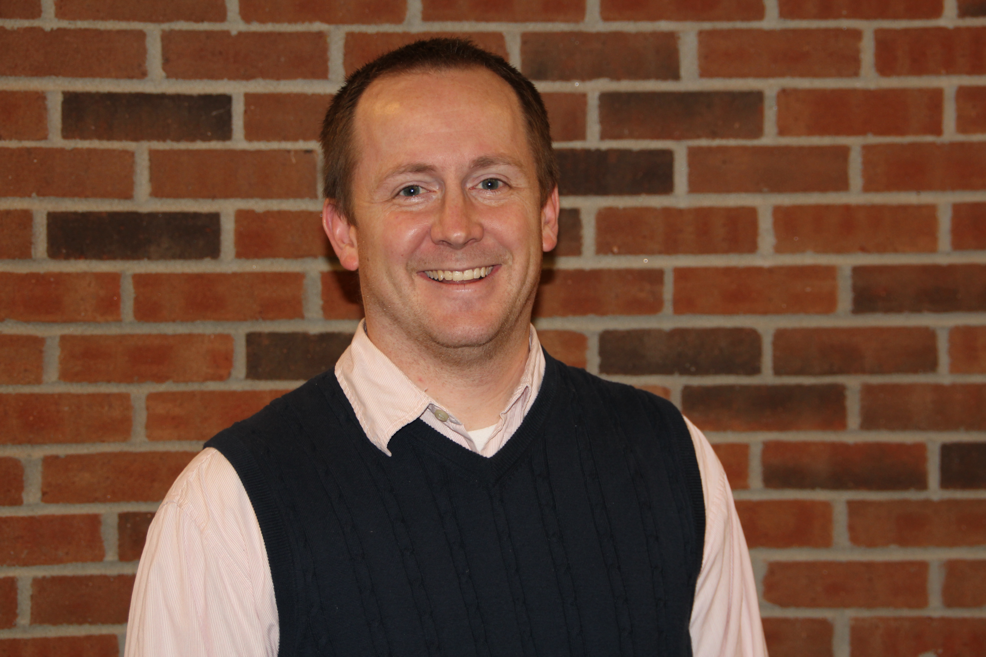
McKnight Crossings Ministry Staff
Jeff Kryder – Senior Minister
Jeremy Picker
Next Gen Worship
Jeremiah Haywood–
Children’s Minister
p. 11

Slide 13
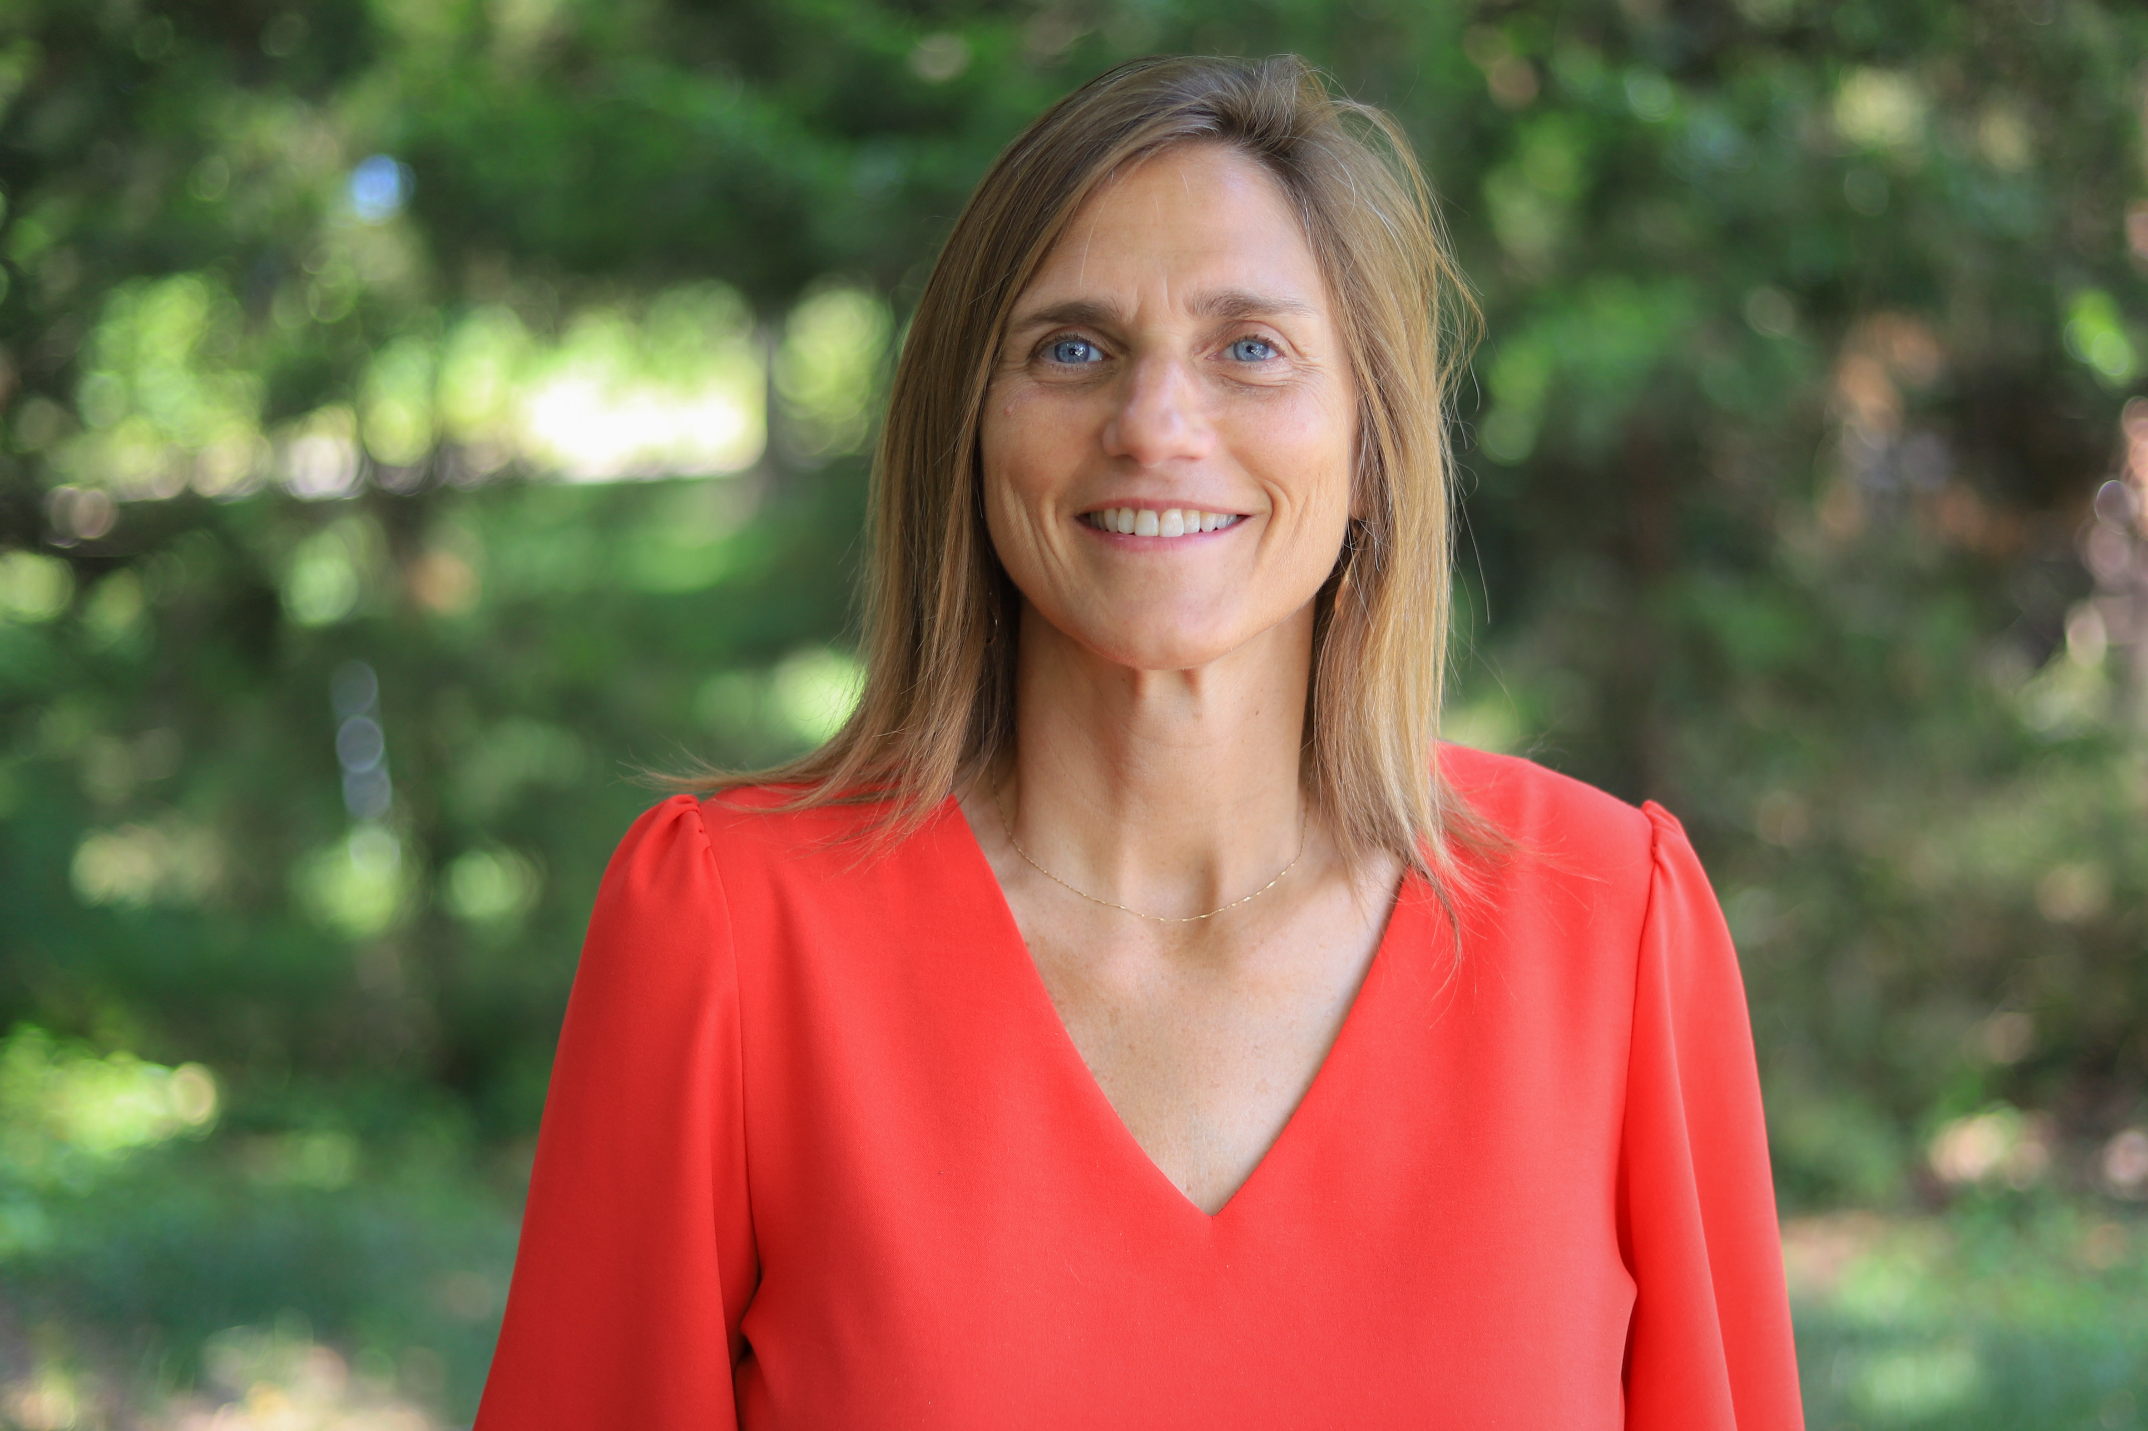
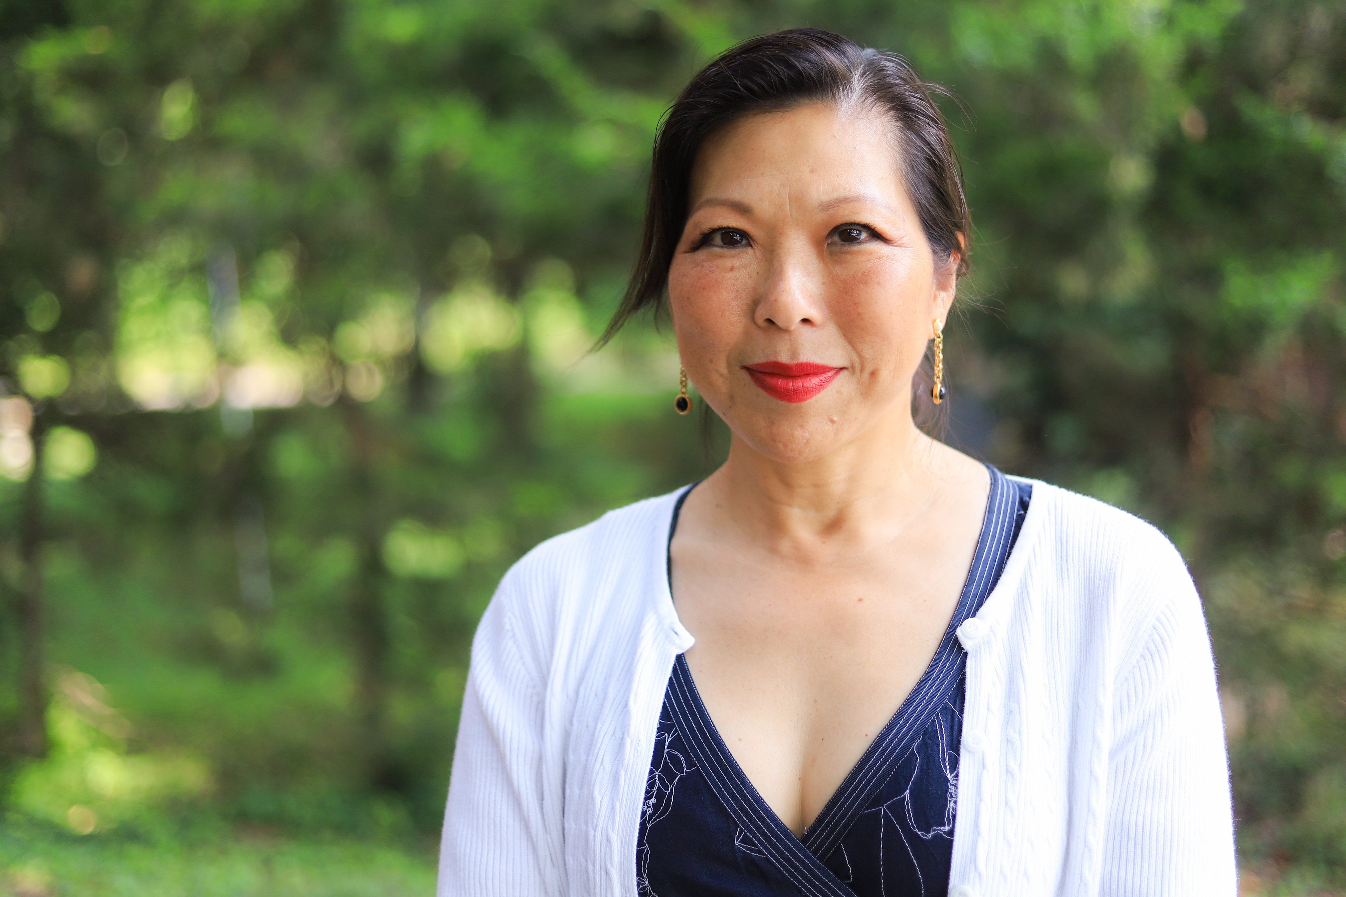
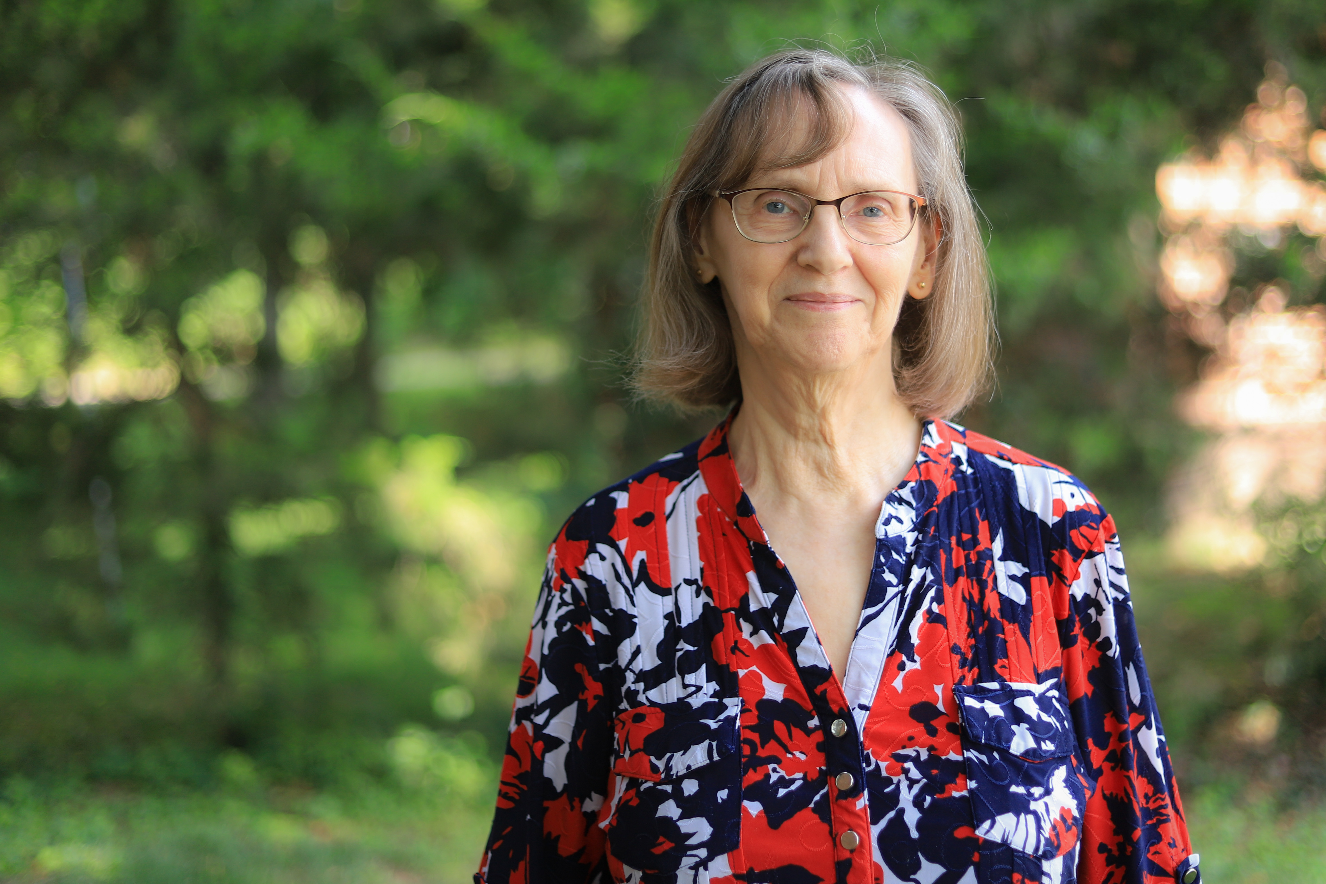
McKnight Crossings Ministry Staff
      Jeannie Britzmann
      Associate Minister
      Elizabeth McPherson
      Office Administrator
      Dolores Miller
      Secretary
p. 12

Slide 14

Outreach Focus
4 Crossings where we focus our welcome
Building (e.g. Food Pantry, Room at the Inn, and Sunday Worship)
Homes (e.g. Connect Groups)
City (e.g. North City Church)
Community (e.g. Local Outreach, Block Party)
p. 13

Slide 15
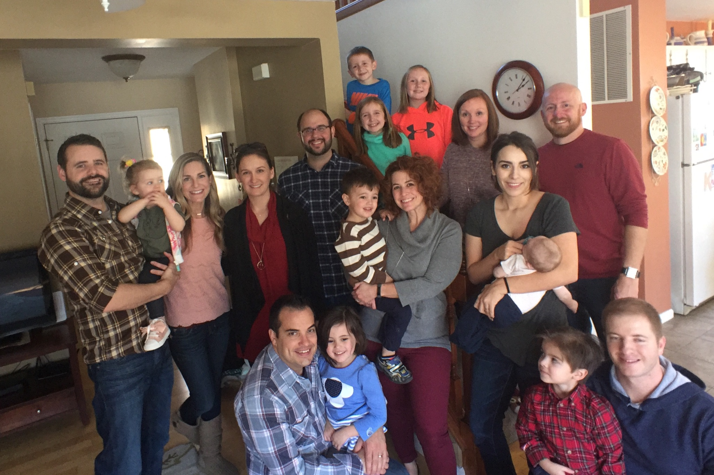
McKnight Crossings
Connect Groups
  Small groups are very important in developing our church life. We aim to grow together through our close interaction.
  Connect Groups meet throughout the week in homes all around the city.
  For a list of groups and help in finding a group for you, contact info@mcknightcrossings.org or jkryder@mcknightcrossings.org.
  Generally, handouts are provided that align with the Sunday message.
  Some of the groups are more geographically based, others are more age specific.
p. 14

Slide 16
McKnight Crossings
Ministries and Contacts – InReach
Adult Christian Formation
– Classes – Jeff Kryder, Betty Vaughn
– Library
Beautify the Building – Kara Karraker
Building and Grounds – Bret Blackford
Children’s Ministry-Jeremiah Haywood
Fellowship Ministry
Finance / Budget – Jeannie Britzmann
Hospitality
Men’s Ministry
Praise Team- Jeremy Picker
Pray & Go-Jeff Kryder, Jeannie Britzmann
Prayer Ministry- Dave Weiler, Jeannie Britzmann
Print/Digital Communications
Safety Ministry – Jerry Mickey
Senior Ministry
Social Media
Sunday Morning Circuit – Dave Weiler, Ben Mehringer
Technology and Audio-Visual
Teen Ministry-
Unity in Diversity – Joyce & Louis West, Todd & Beth Mayberry
Website – Elizabeth McPherson
Women’s Ministry
Worship – Jeremy Picker, Jeff Kryder
p. 15

Slide 17
McKnight Crossings
Ministries and Contacts – OutReach
Benevolence – Outreach
  Food Pantry –Barb Eickele
  Room At The Inn
  Snowflakes for Warmth
  Fall Food Drive
Camp Ne-O-Tez – Steve Jones
Connect Groups – Jeff Kryder, Dale Simpson
Greeters’ Ministry – Fredy Griffith
Local Missions and Community Outreach
  ACTS Campus Ministry – Katie Holloway
  Christian Family Services –Steve Awtrey
  Local Outreach Ministry – Jeff Kryder
Missions Committee and Missions –Jeff & Beata McGlawn, Jim & Fredy Griffith
  Marseille, France
  Mauritius
  Panama
Urban Outreach
  North City –Dave & Amy Weiler
p. 16

Slide 18
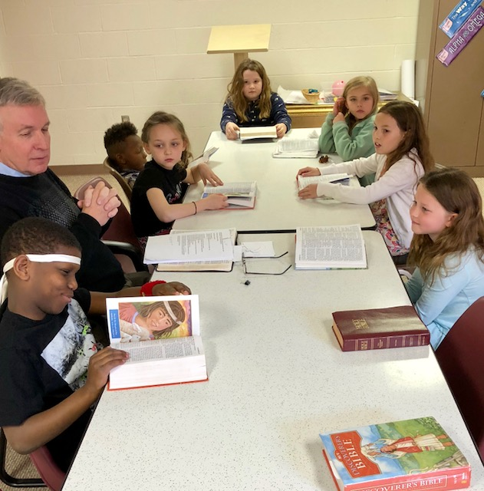
McKnight Crossings kidsCROSSINGS
At kidsCROSSINGS, we want to provide an environment for each child to be engaged with other students and with God.
In the preschool age group (2-4 years old), our goal is that every student know with all of their heart that: God made them and God loves them; Jesus wants to be their friend FOREVER!
As the kids get older (5 yrs. - 5th grade) and begin to discover God more fully, our goal is that each student understands 3 basic truths: FAITH: I can trust God no matter what; WISDOM: I need to make the wise choice; FRIENDSHIP: I should treat others the way I want to be treated.
These basic truths are at the core of Jesus’s teachings and life. Understanding these core truths is the first step in developing a passion for serving God for the rest of their lives.
p. 17

Slide 19
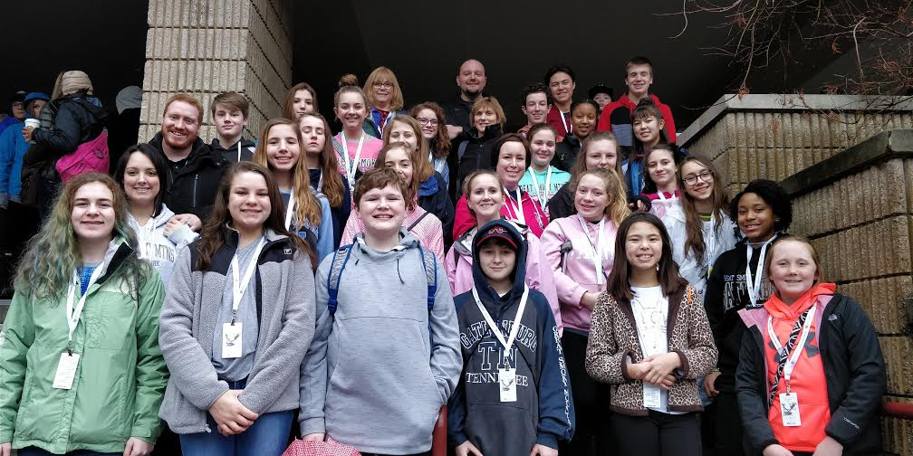
McKnight Crossings
Teen Ministry
Purpose Statement: Our Student Ministry desires to REACH non-believing students, to CONNECT them with other Christians, to help them GROW in their faith, to DISCOVER their ministry, and HONOR God with their life.
In our Student Ministry, we want to provide an environment for each child to be engaged with other students and with God. We meet for Sunday morning worship and have planned events throughout the year such as Wednesday night youth group, service projects, mission trips, and Bible study.
E-mail Michalie Brown or call 314-962-7026.
p. 18

Slide 20
What members of this church are expected to do.
The Shepherds ask that McKnight Crossings members be committed to:
Delight in God. Encourage One Another. Serve Eagerly.
Learn to love God deeply through prayer and worship.
Develop relationships (find a Connect Group and always speak positively of one another).
Use your gifts to serve the body and the community.
Give generously.
p. 19

